Slide 1
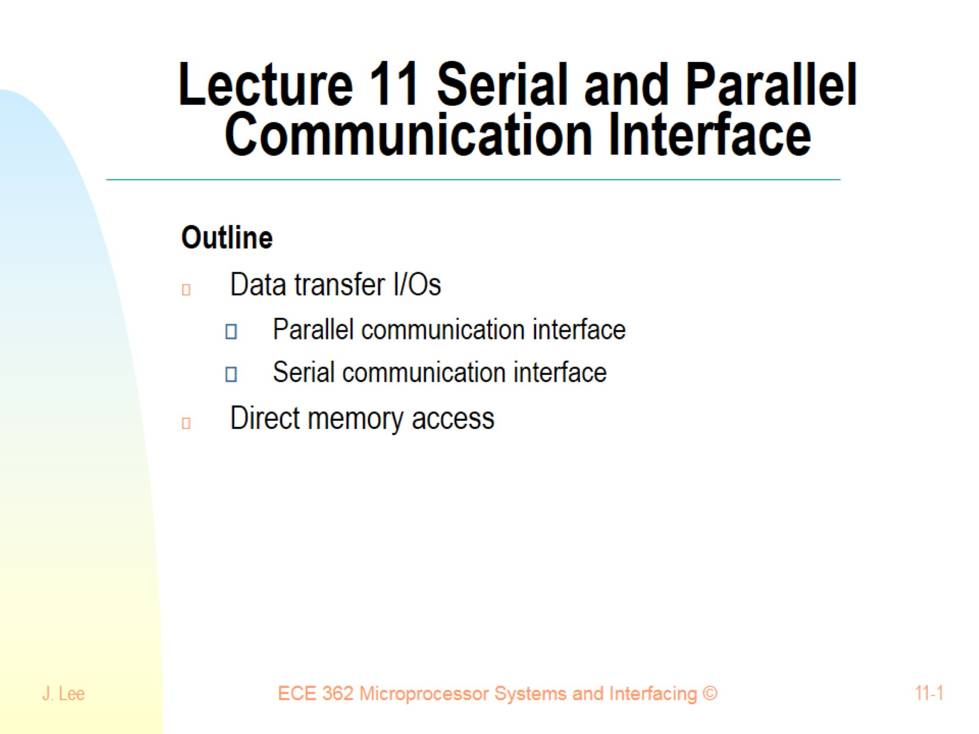
Lecture 11 Serial and Parallel Communication Interface

Slide 2
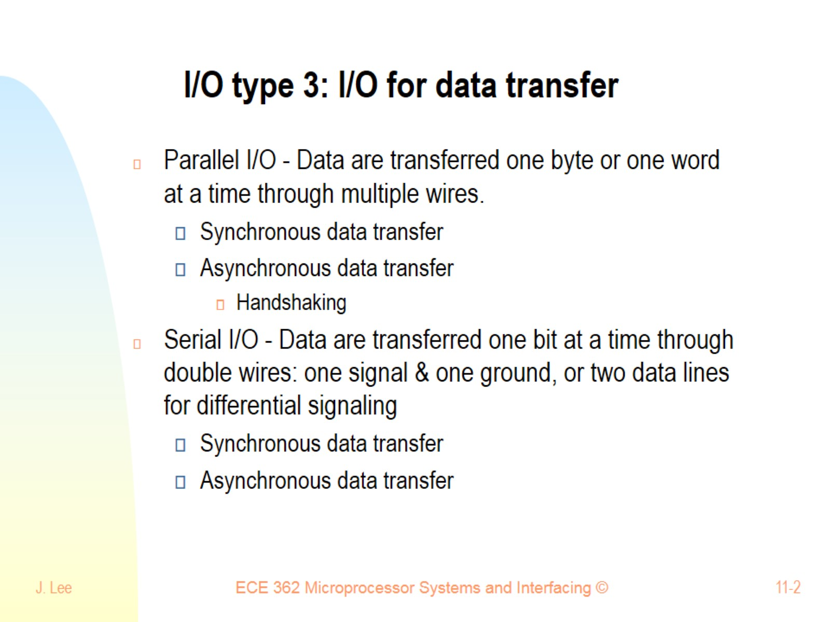
I/O type 3: I/O for data transfer

Slide 3
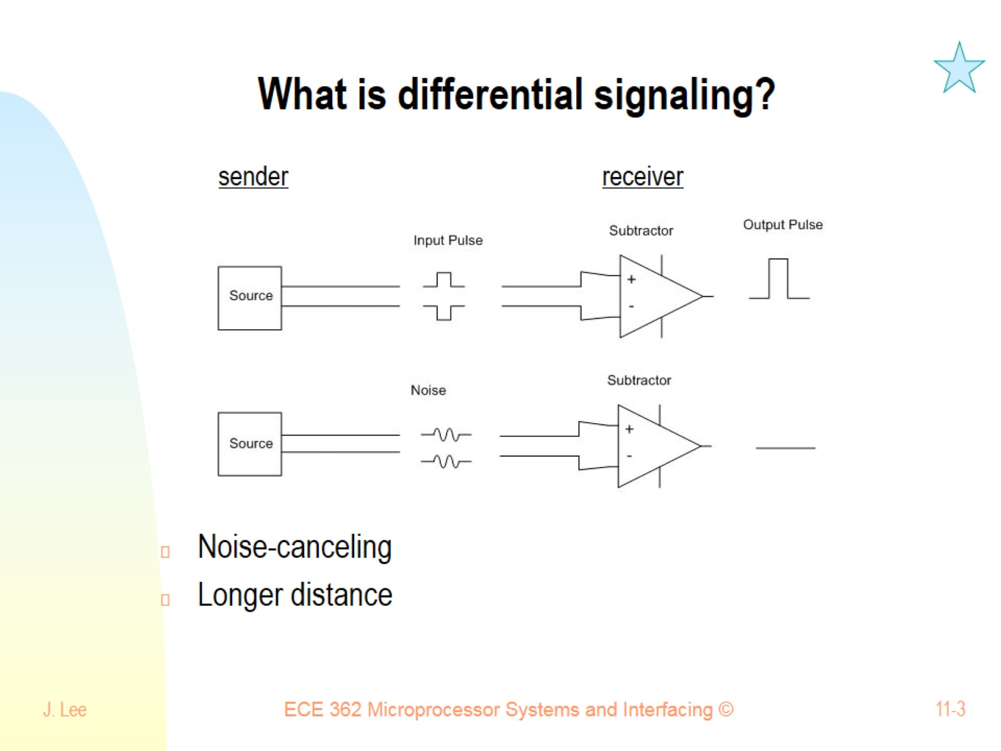
What is differential signaling?

Slide 4
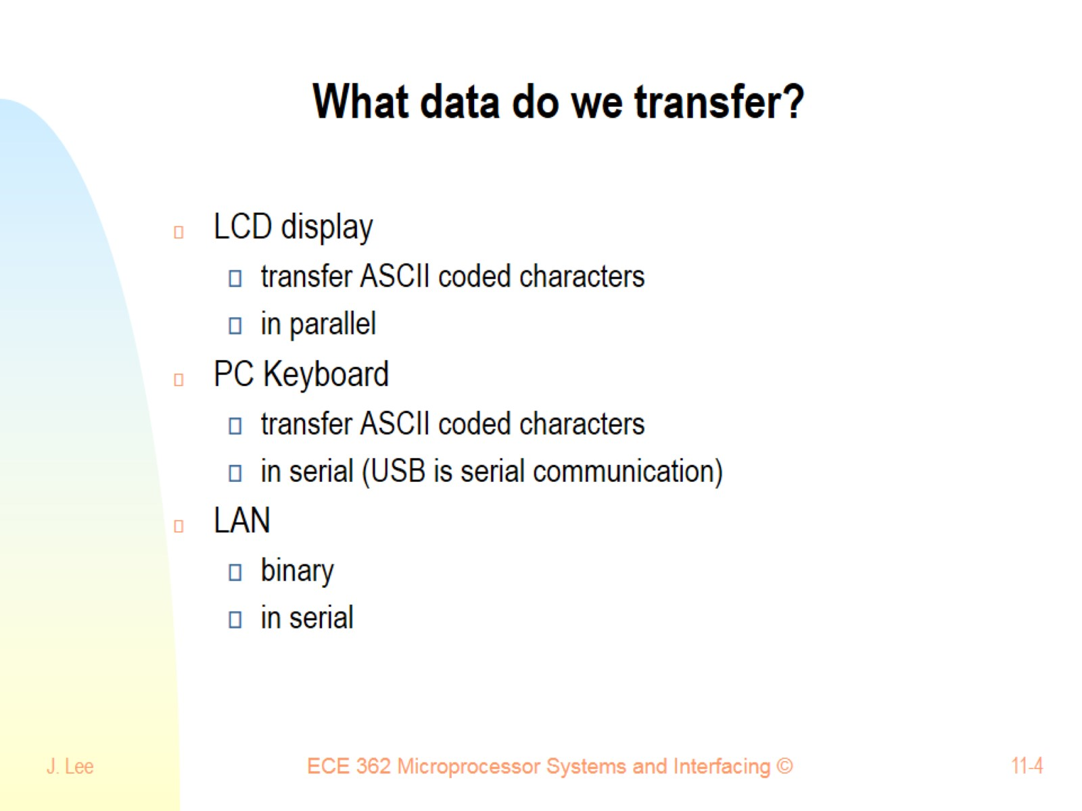
What data do we transfer?

Slide 5
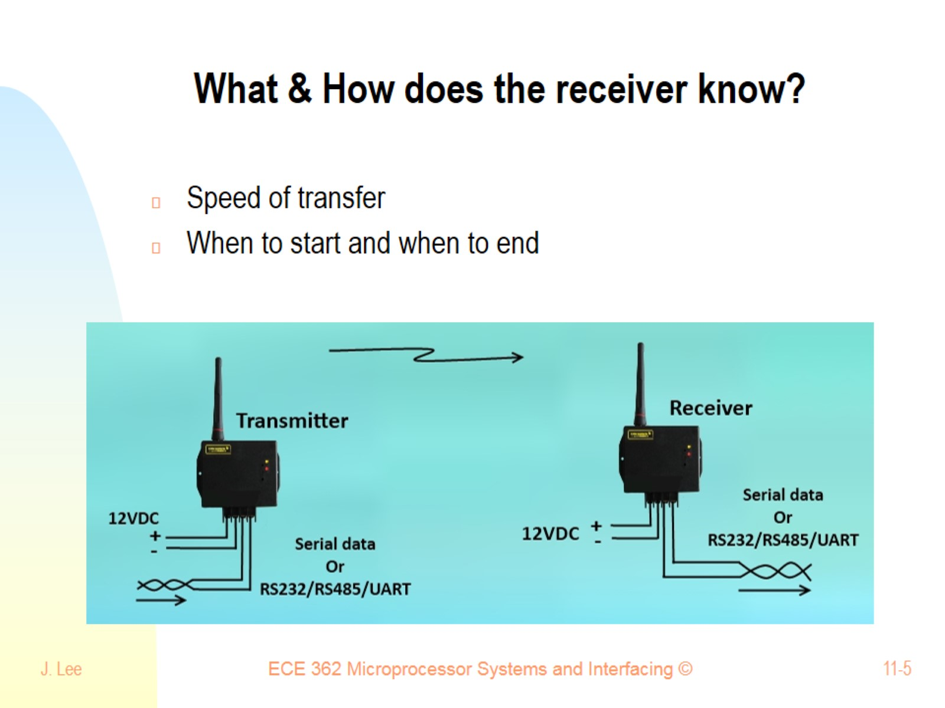
What & How does the receiver know?

Slide 6
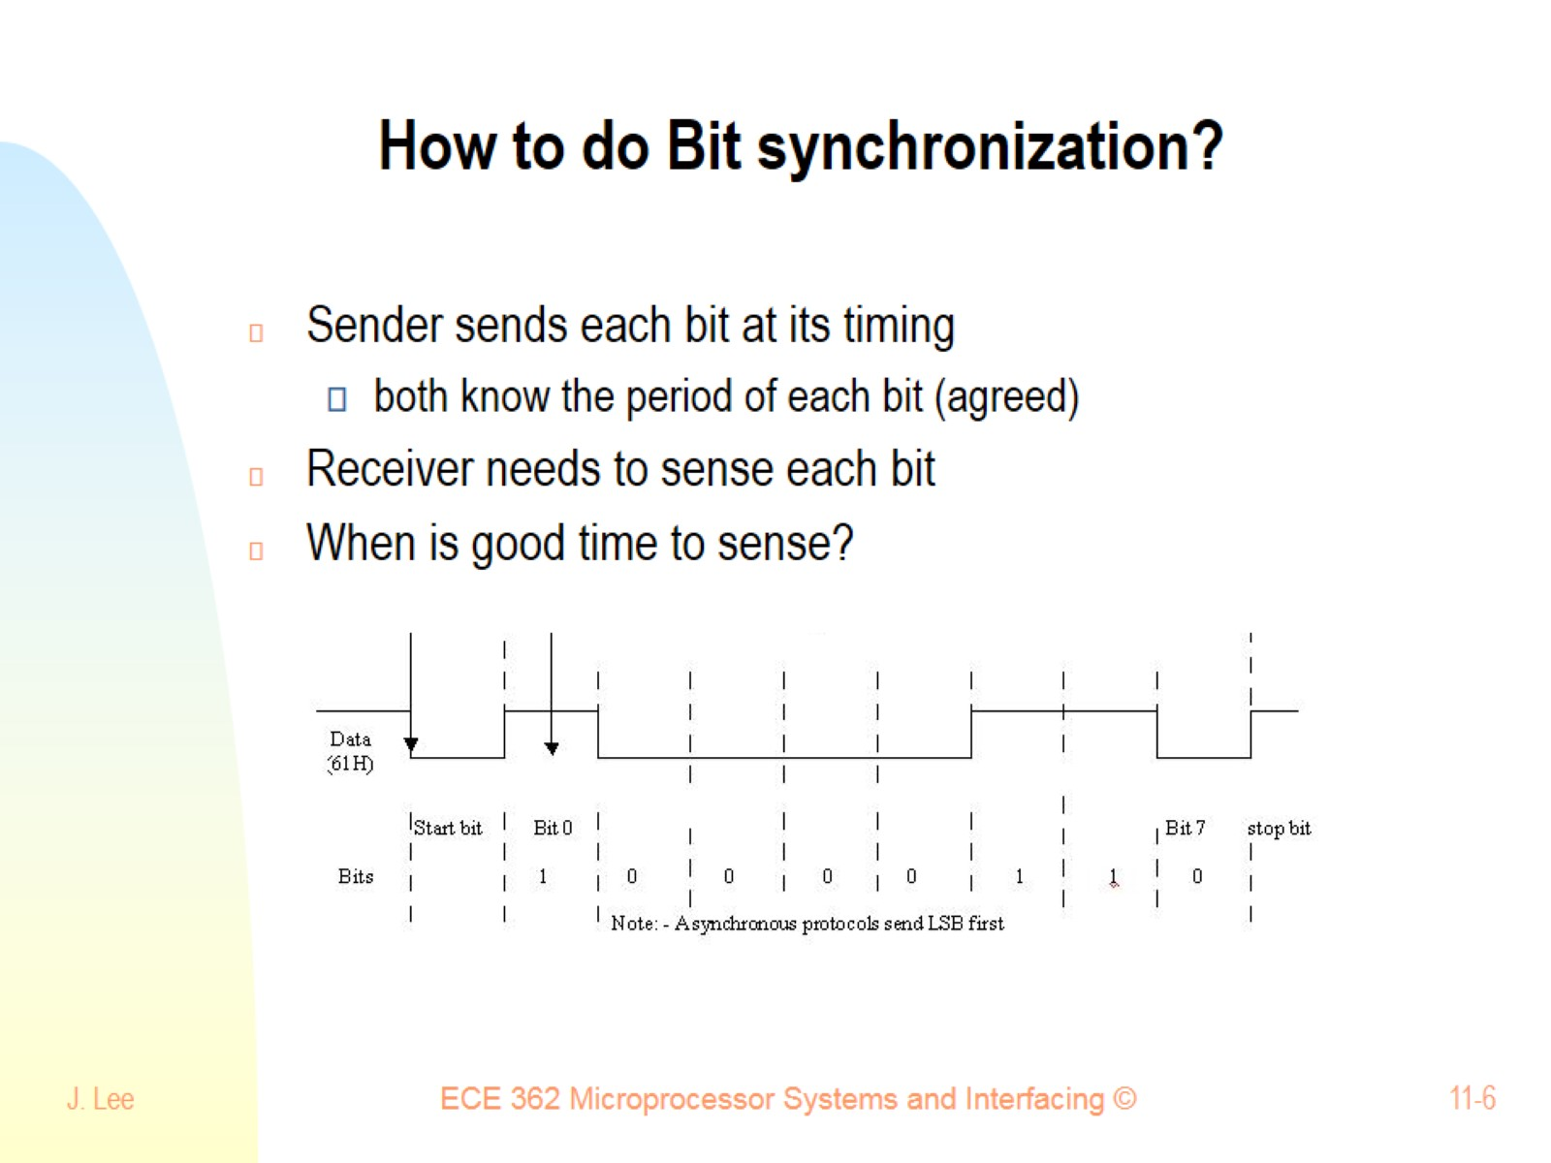
How to do Bit synchronization?

Slide 7
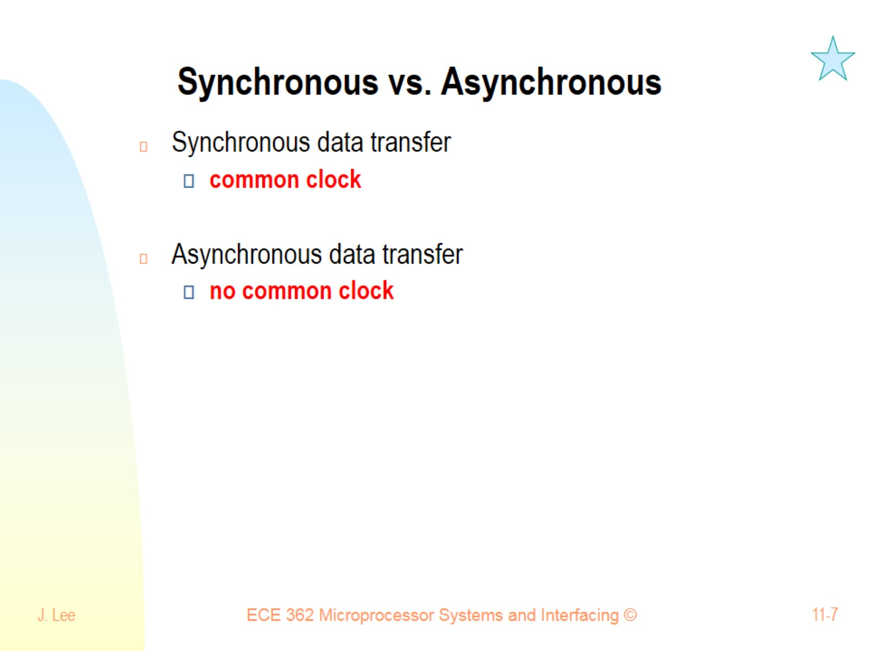
Synchronous vs. Asynchronous

Slide 8
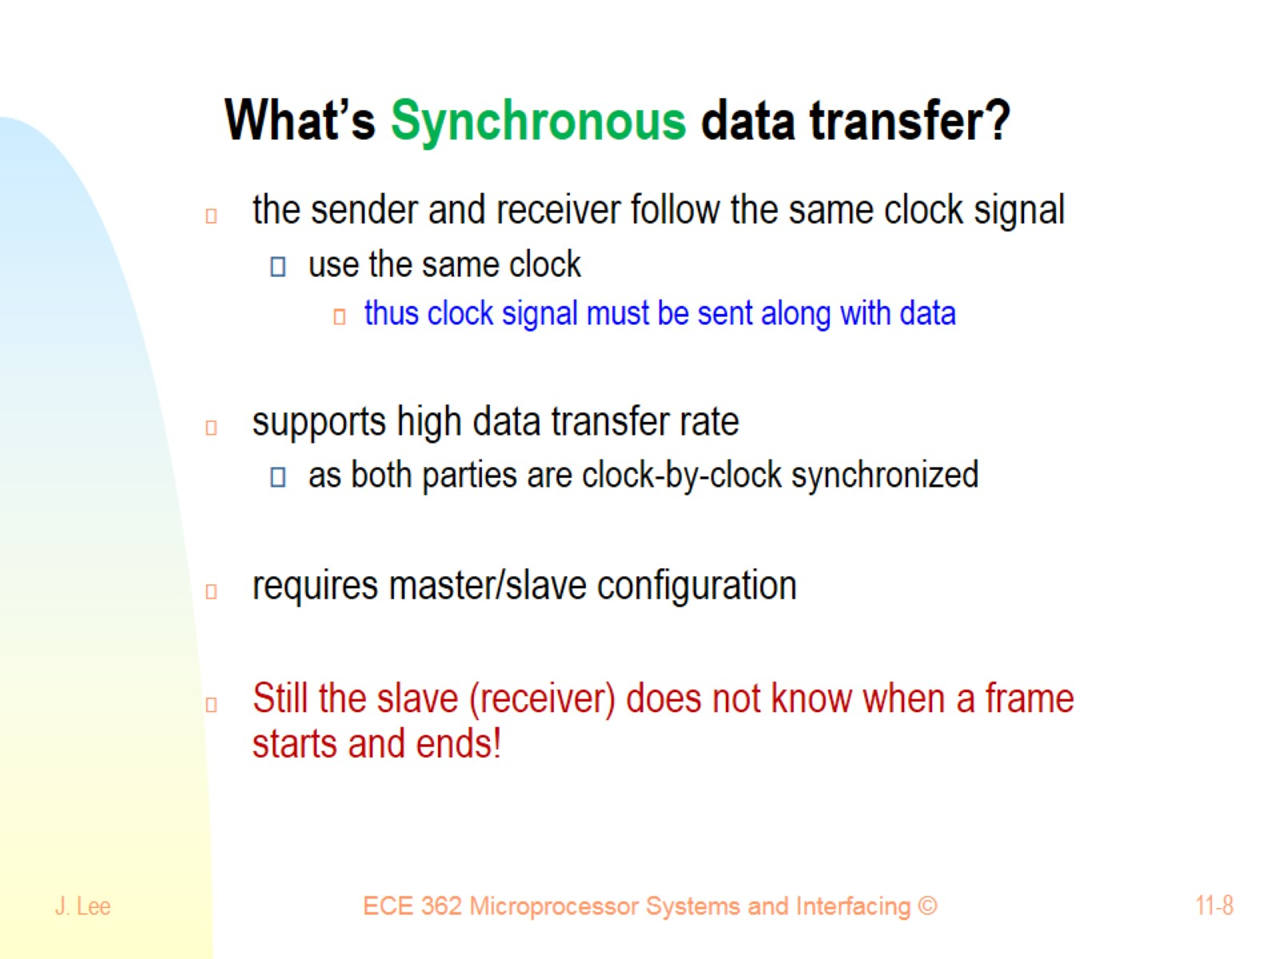
What’s Synchronous data transfer?

Slide 9
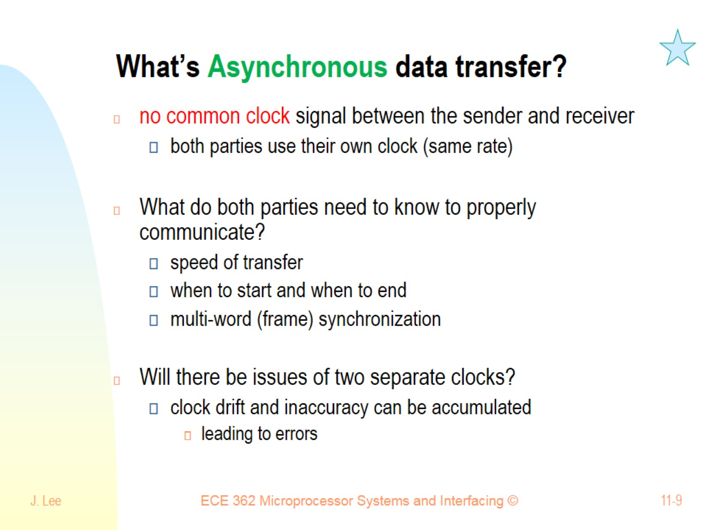
What’s Asynchronous data transfer?

Slide 10
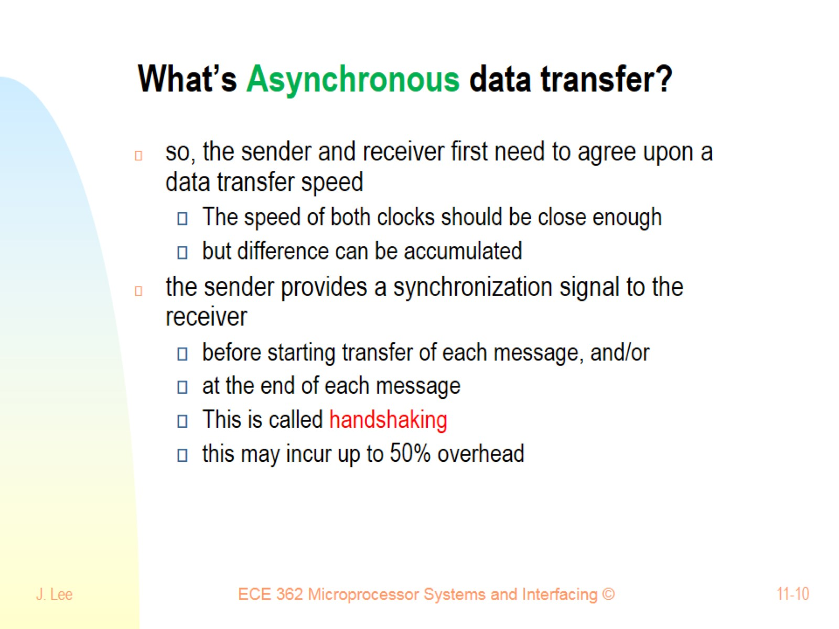
What’s Asynchronous data transfer?

Slide 11
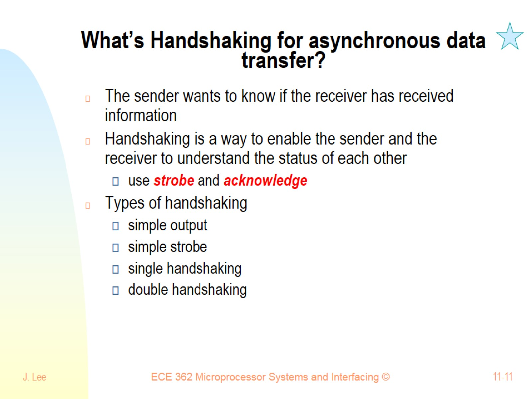
What’s Handshaking for asynchronous data transfer?

Slide 12
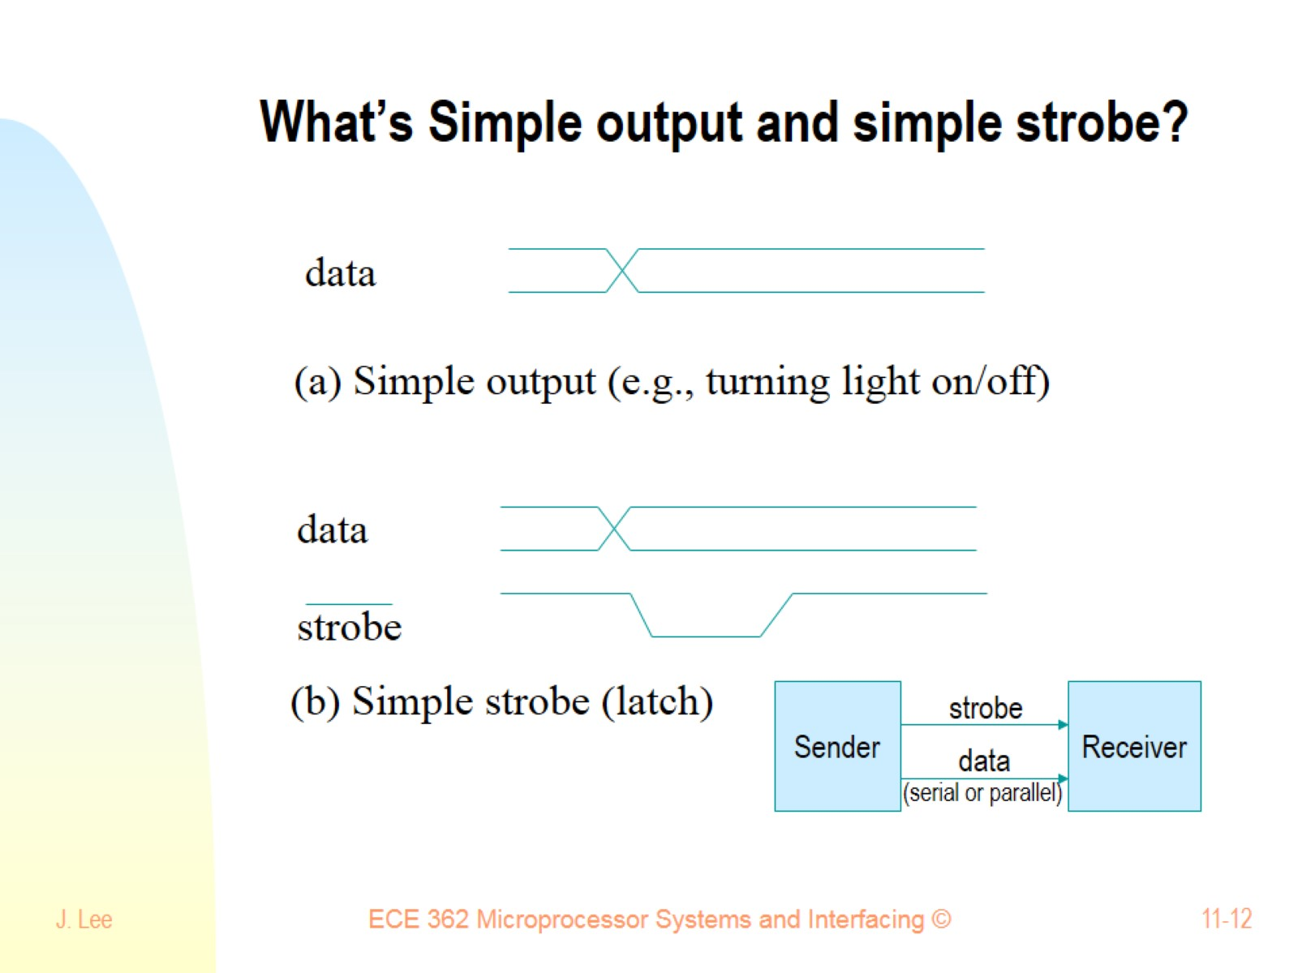
What’s Simple output and simple strobe?

Slide 13
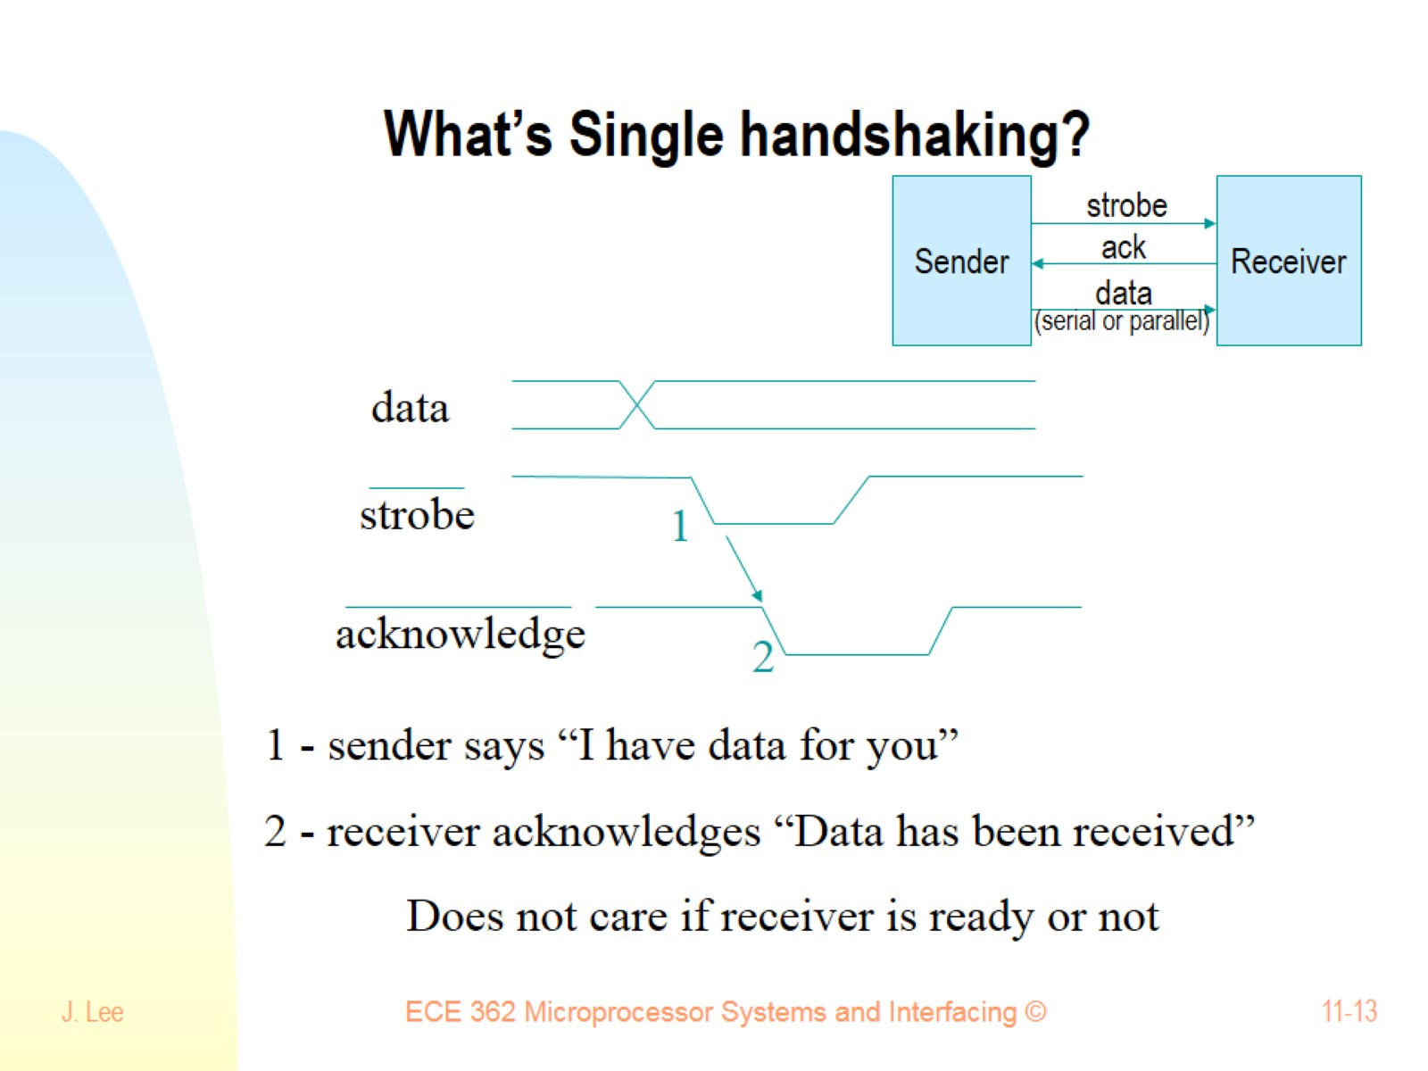
What’s Single handshaking?

Slide 14
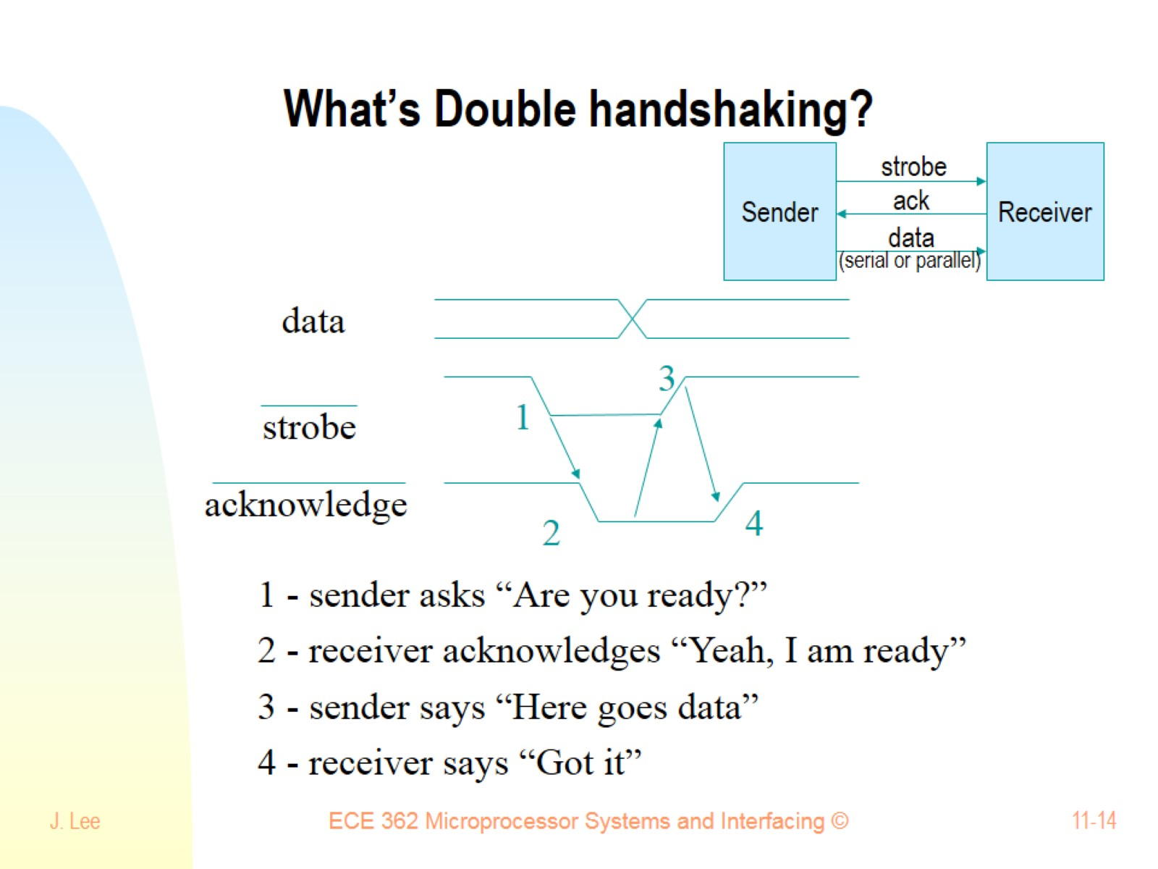
What’s Double handshaking?

Slide 15
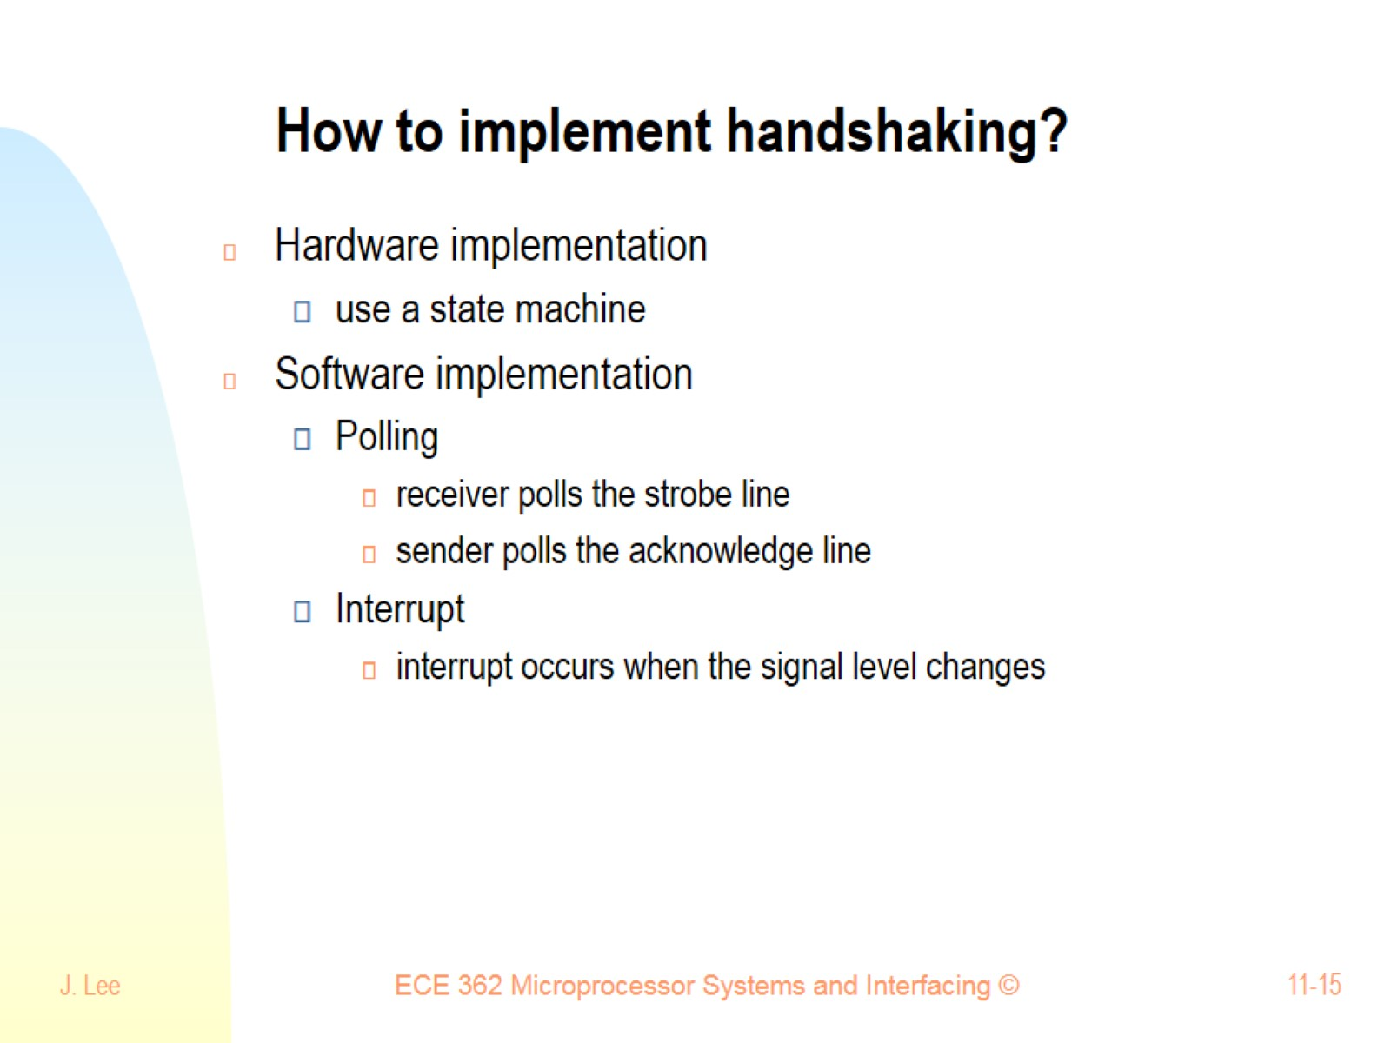
How to implement handshaking?

Slide 16
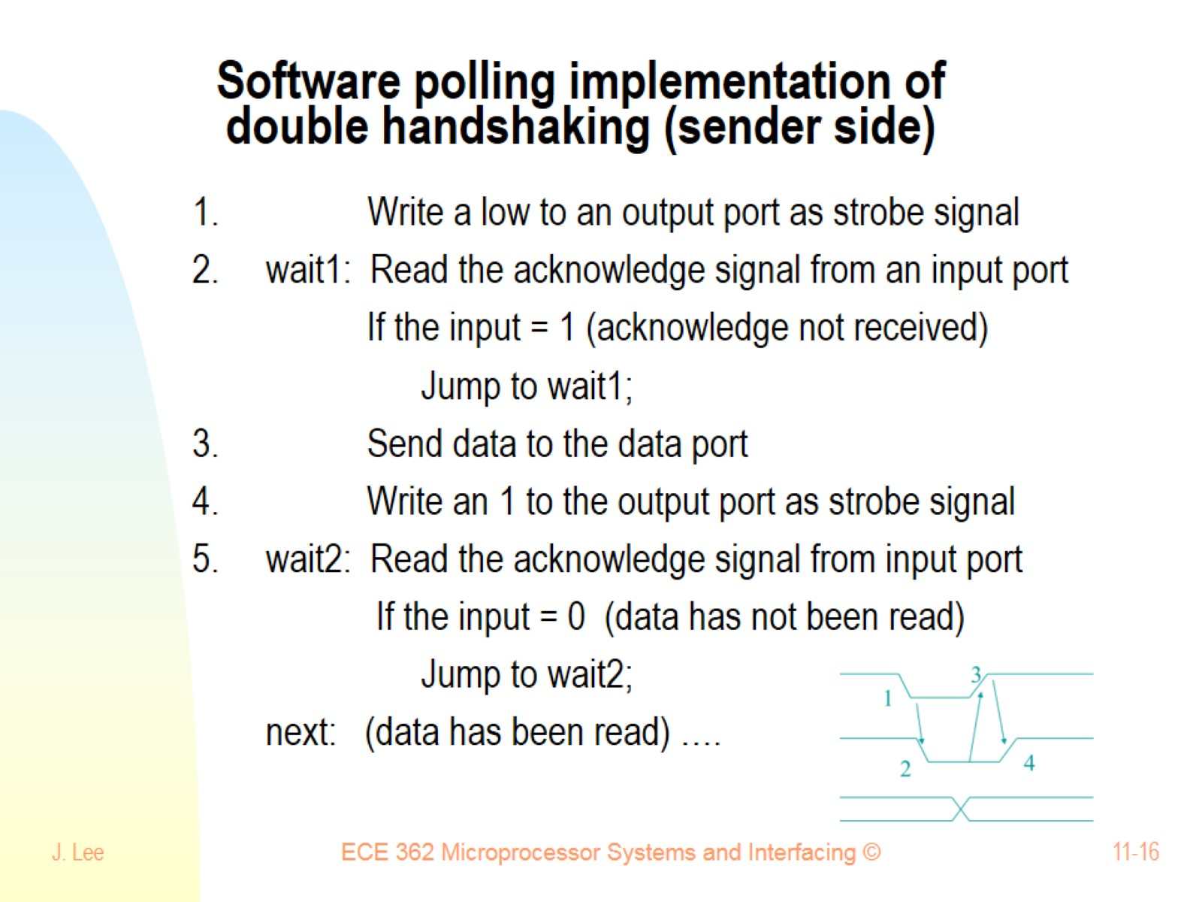
Software polling implementation of double handshaking (sender side)

Slide 17
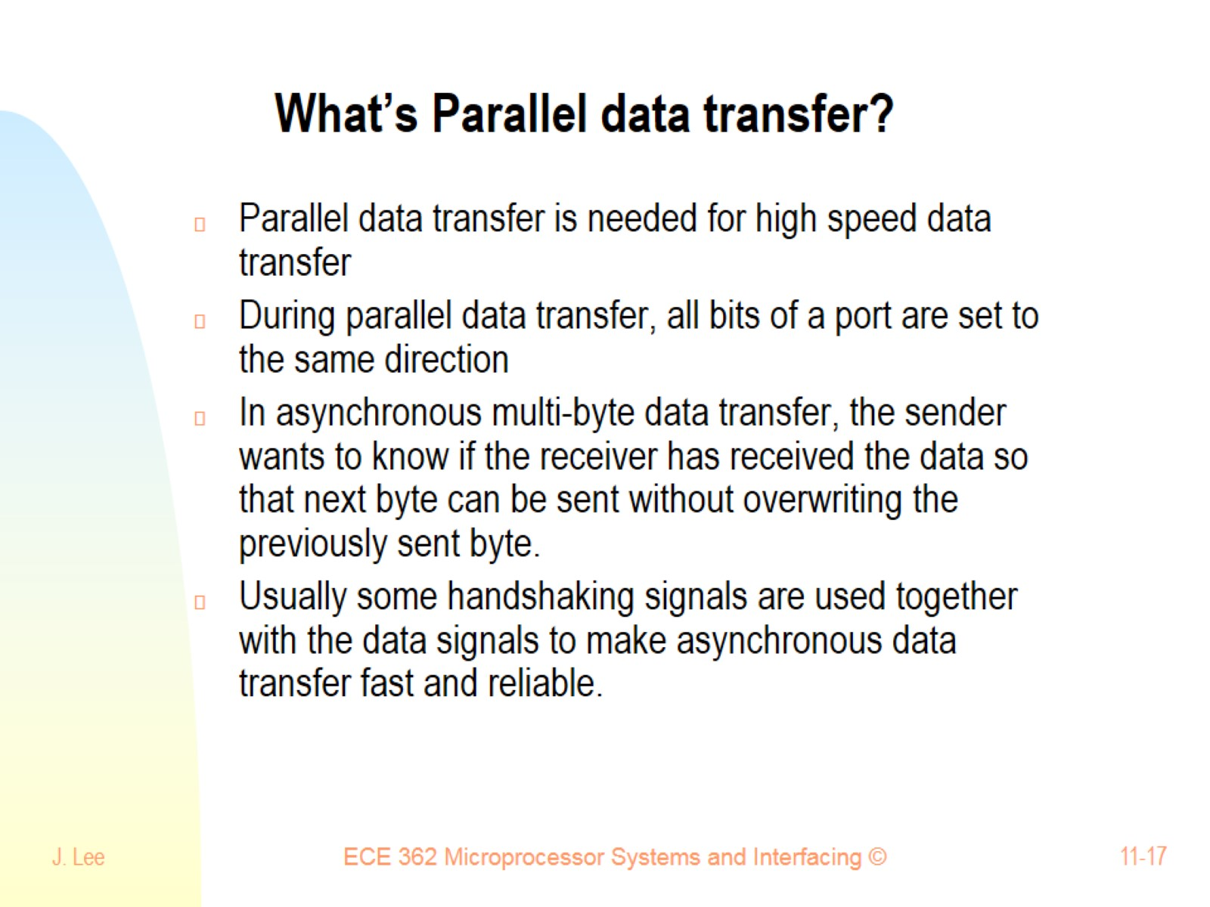
What’s Parallel data transfer?

Slide 18
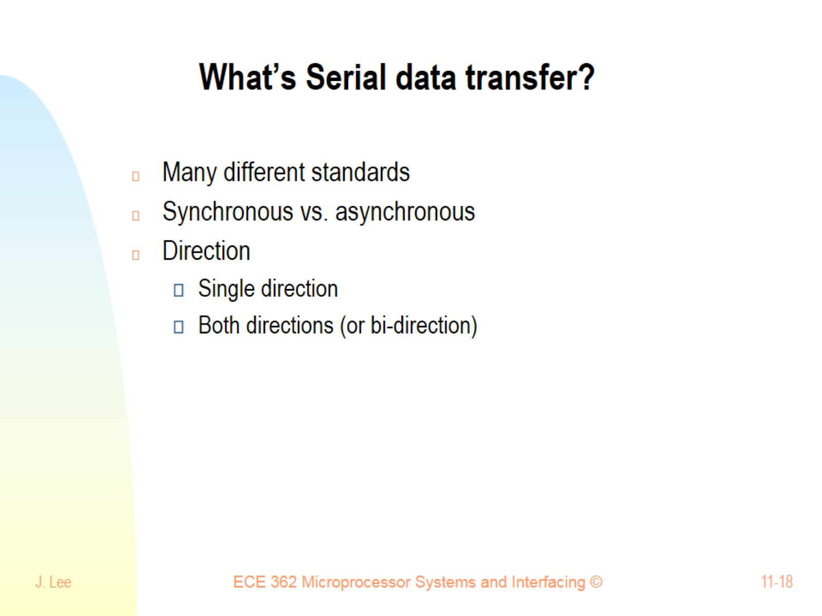
What’s Serial data transfer?

Slide 19
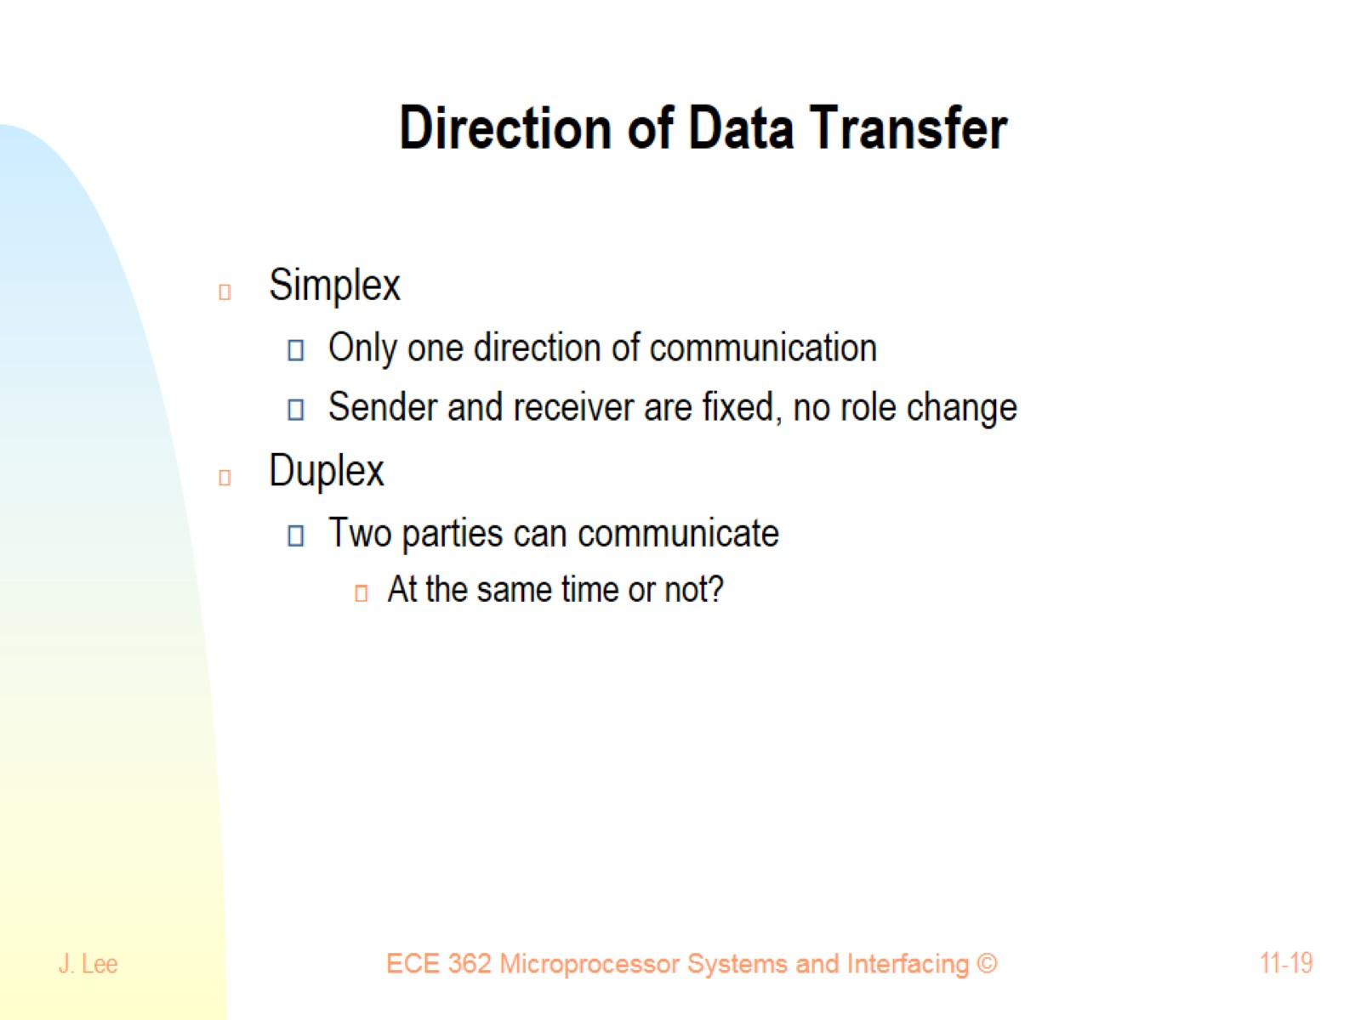
Direction of Data Transfer

Slide 20
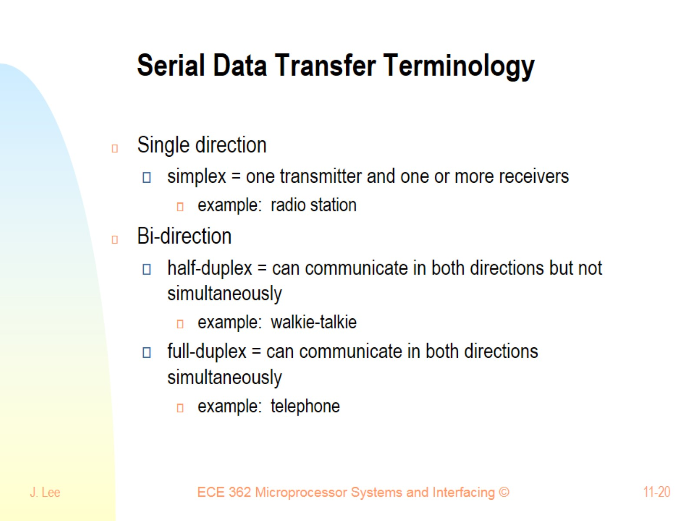
Serial Data Transfer Terminology

Slide 21
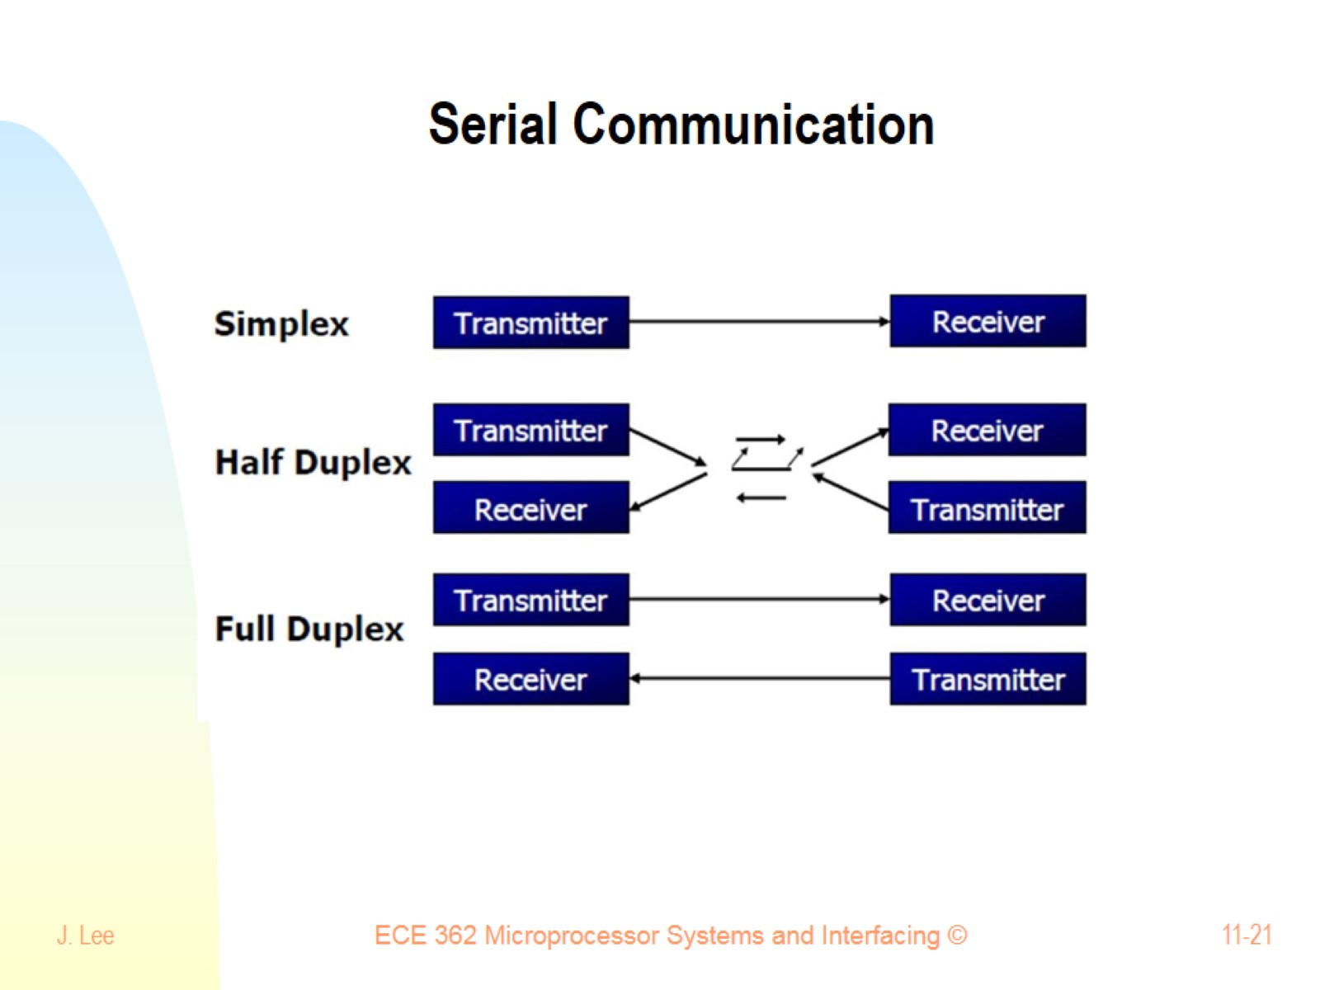
Serial Communication

Slide 22
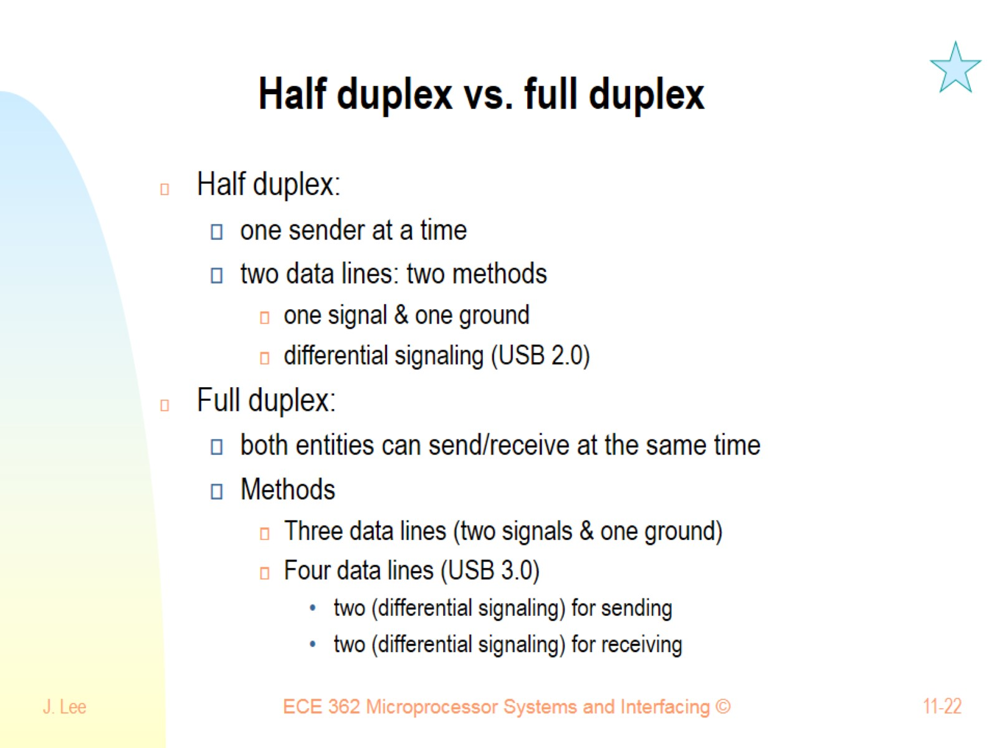
Half duplex vs. full duplex

Slide 23
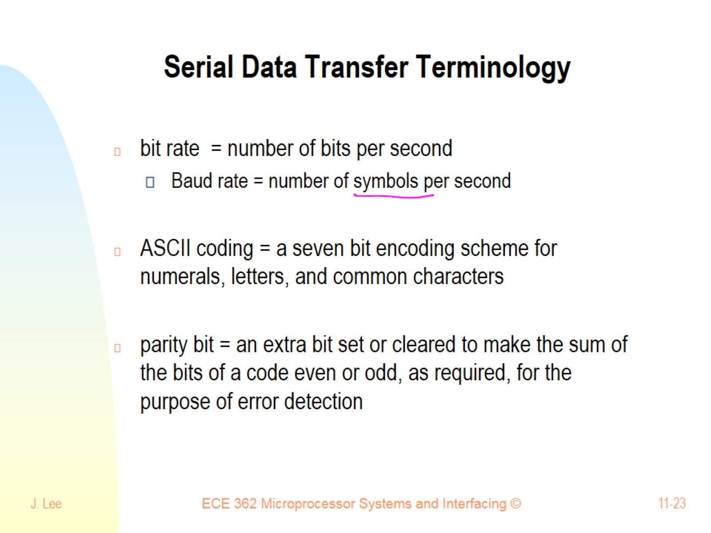
Serial Data Transfer Terminology

Slide 24
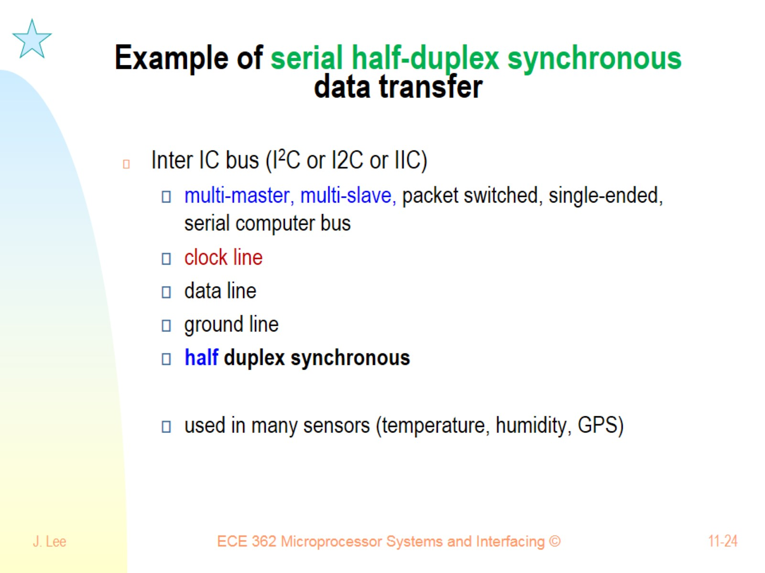
Example of serial half-duplex synchronous data transfer

Slide 25
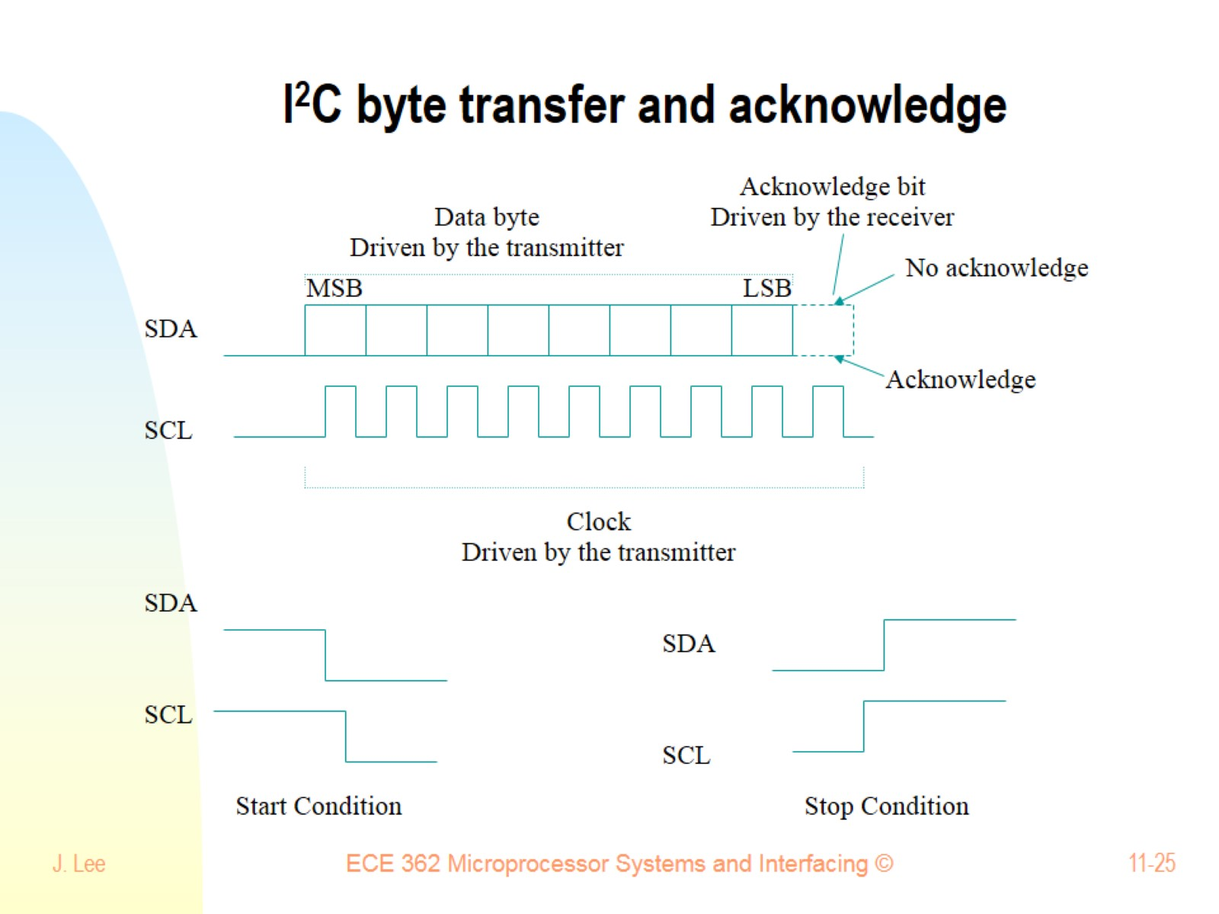
I²C byte transfer and acknowledge

Slide 26
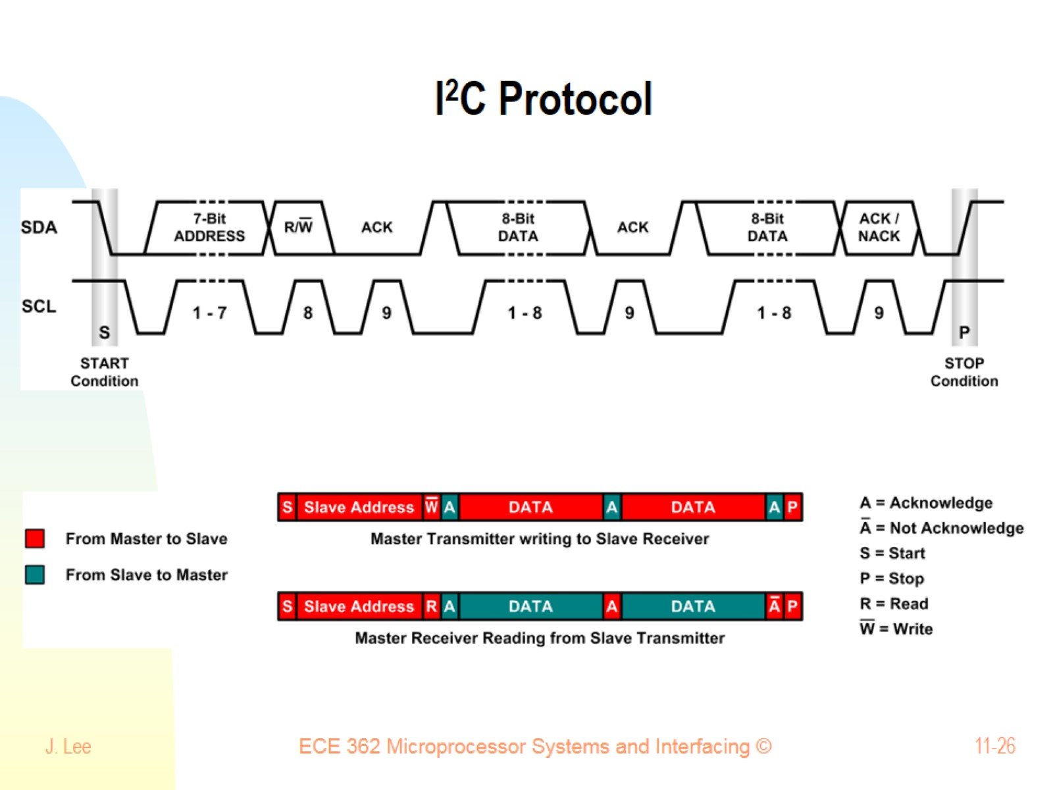
I²C Protocol

Slide 27
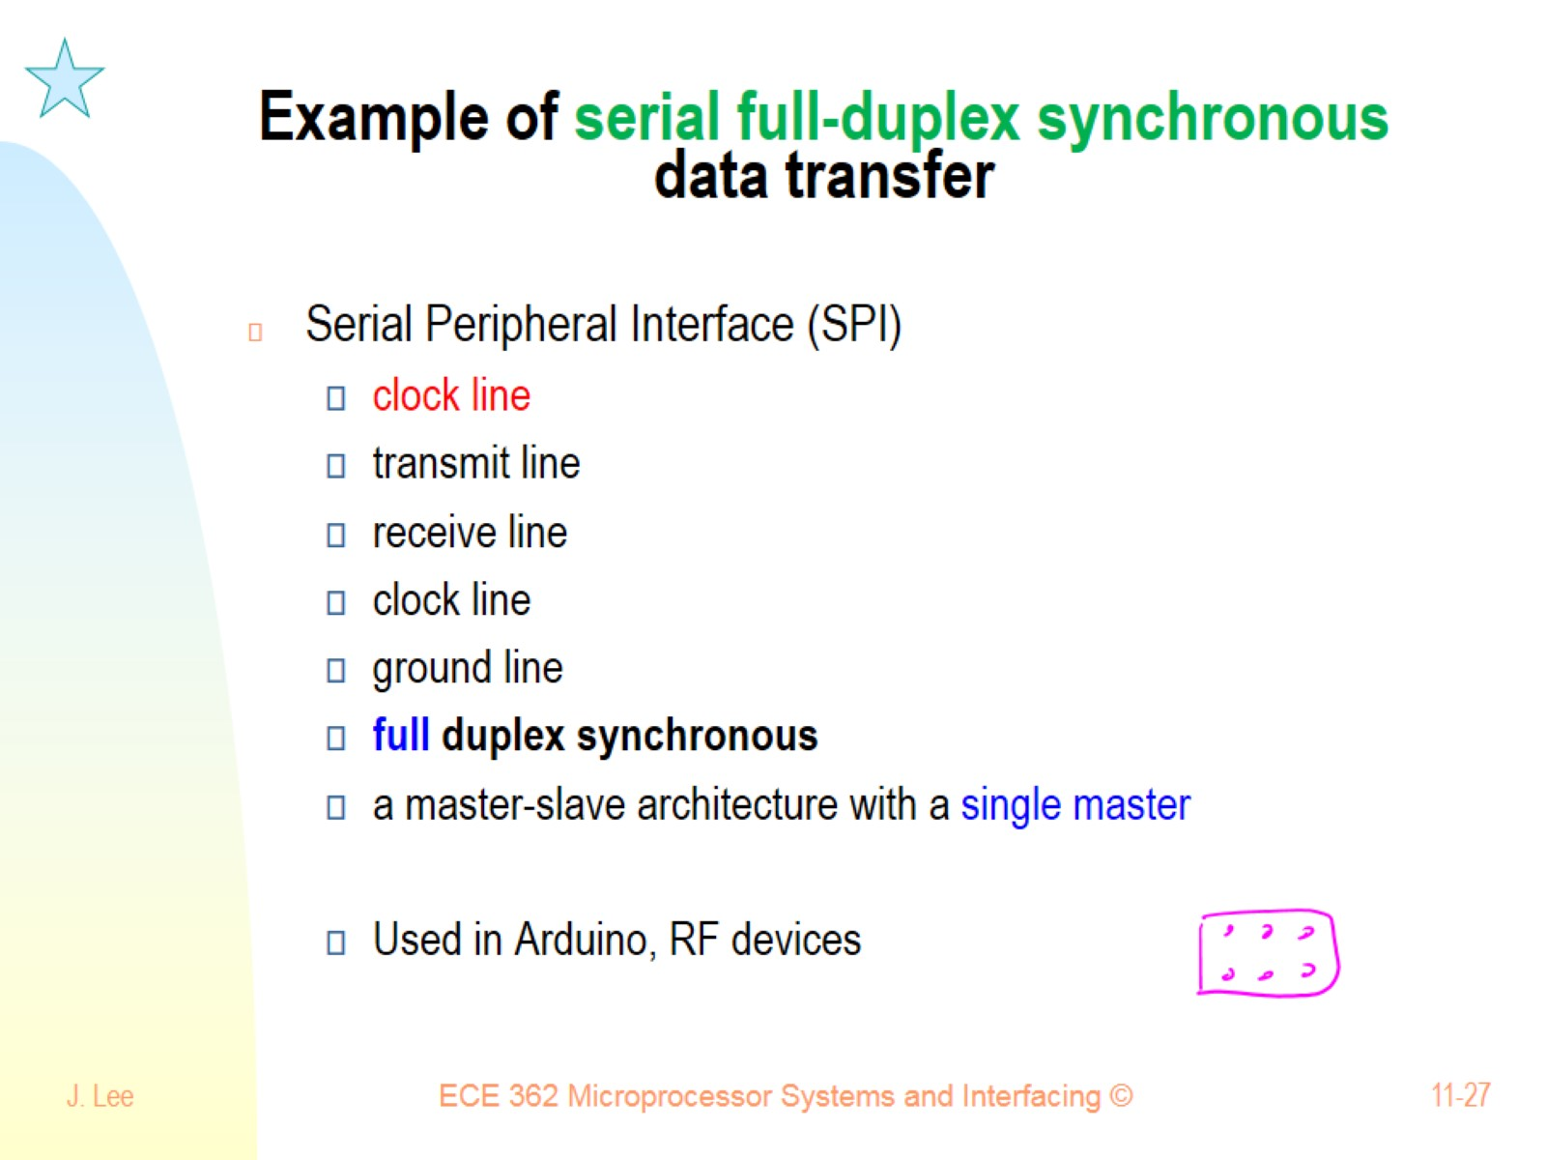
Example of serial full-duplex synchronous data transfer

Slide 28
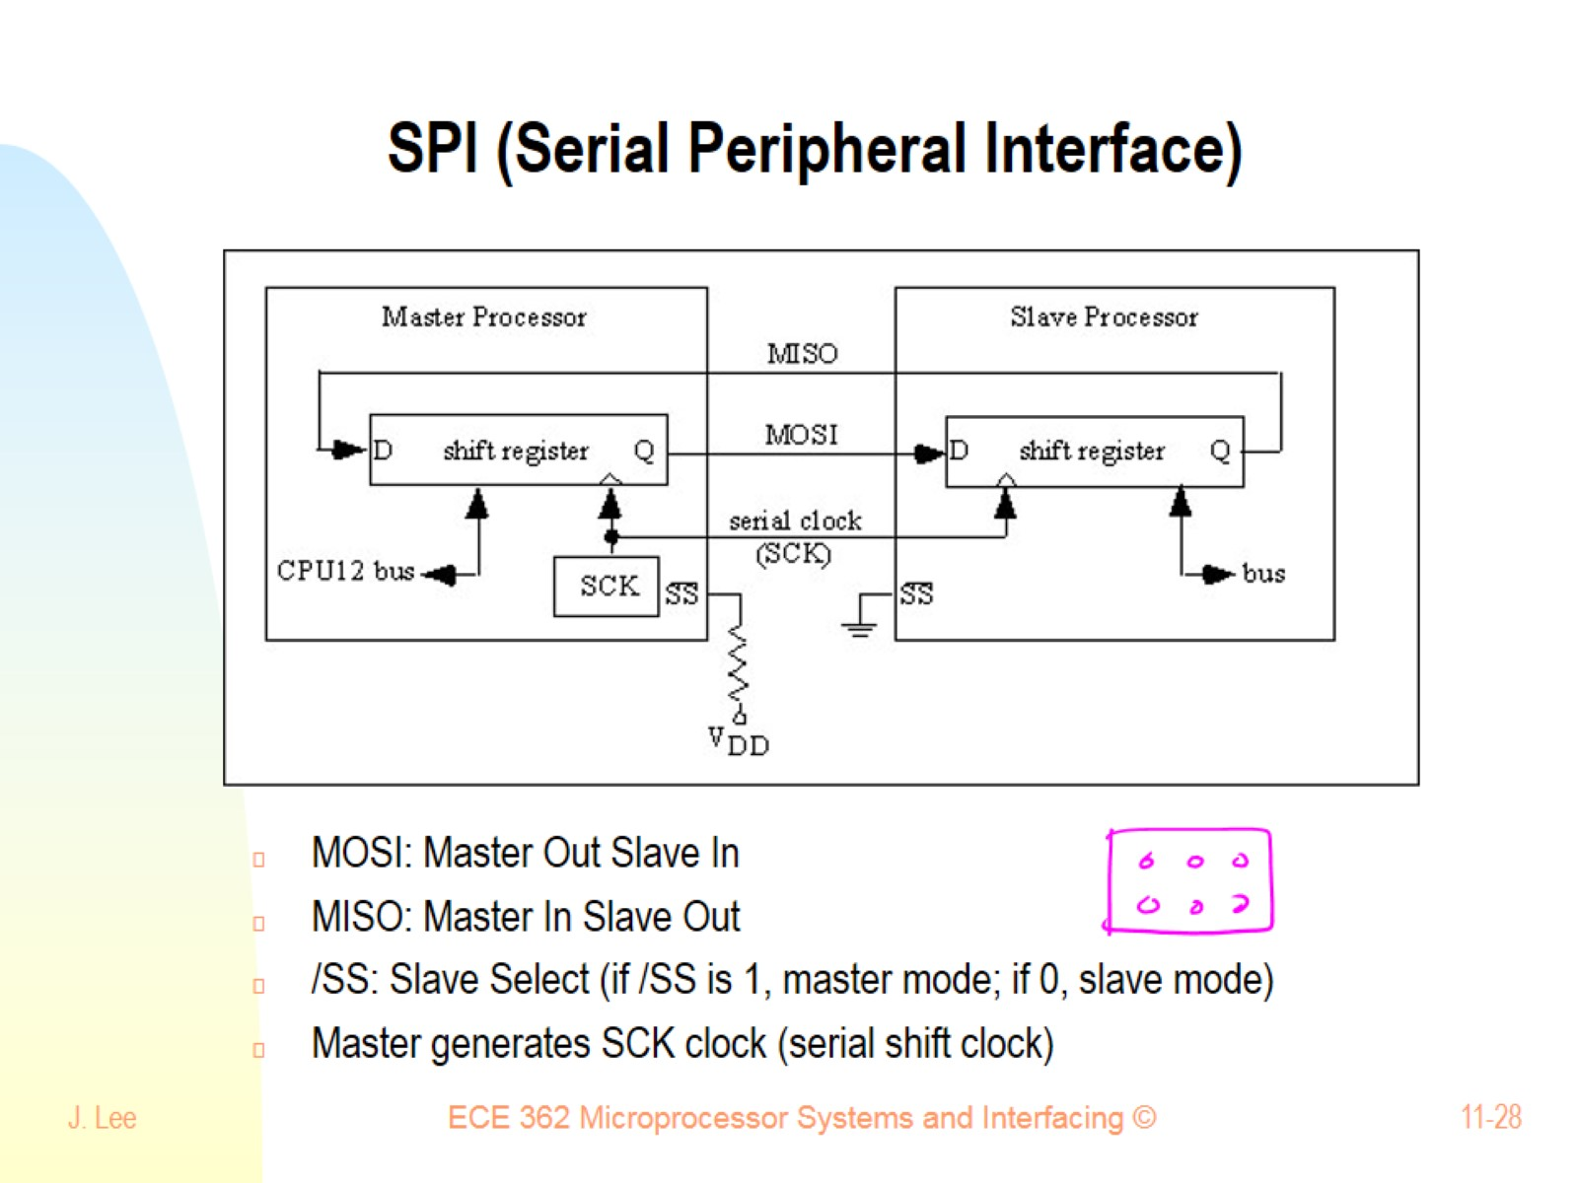
SPI (Serial Peripheral Interface)

Slide 29
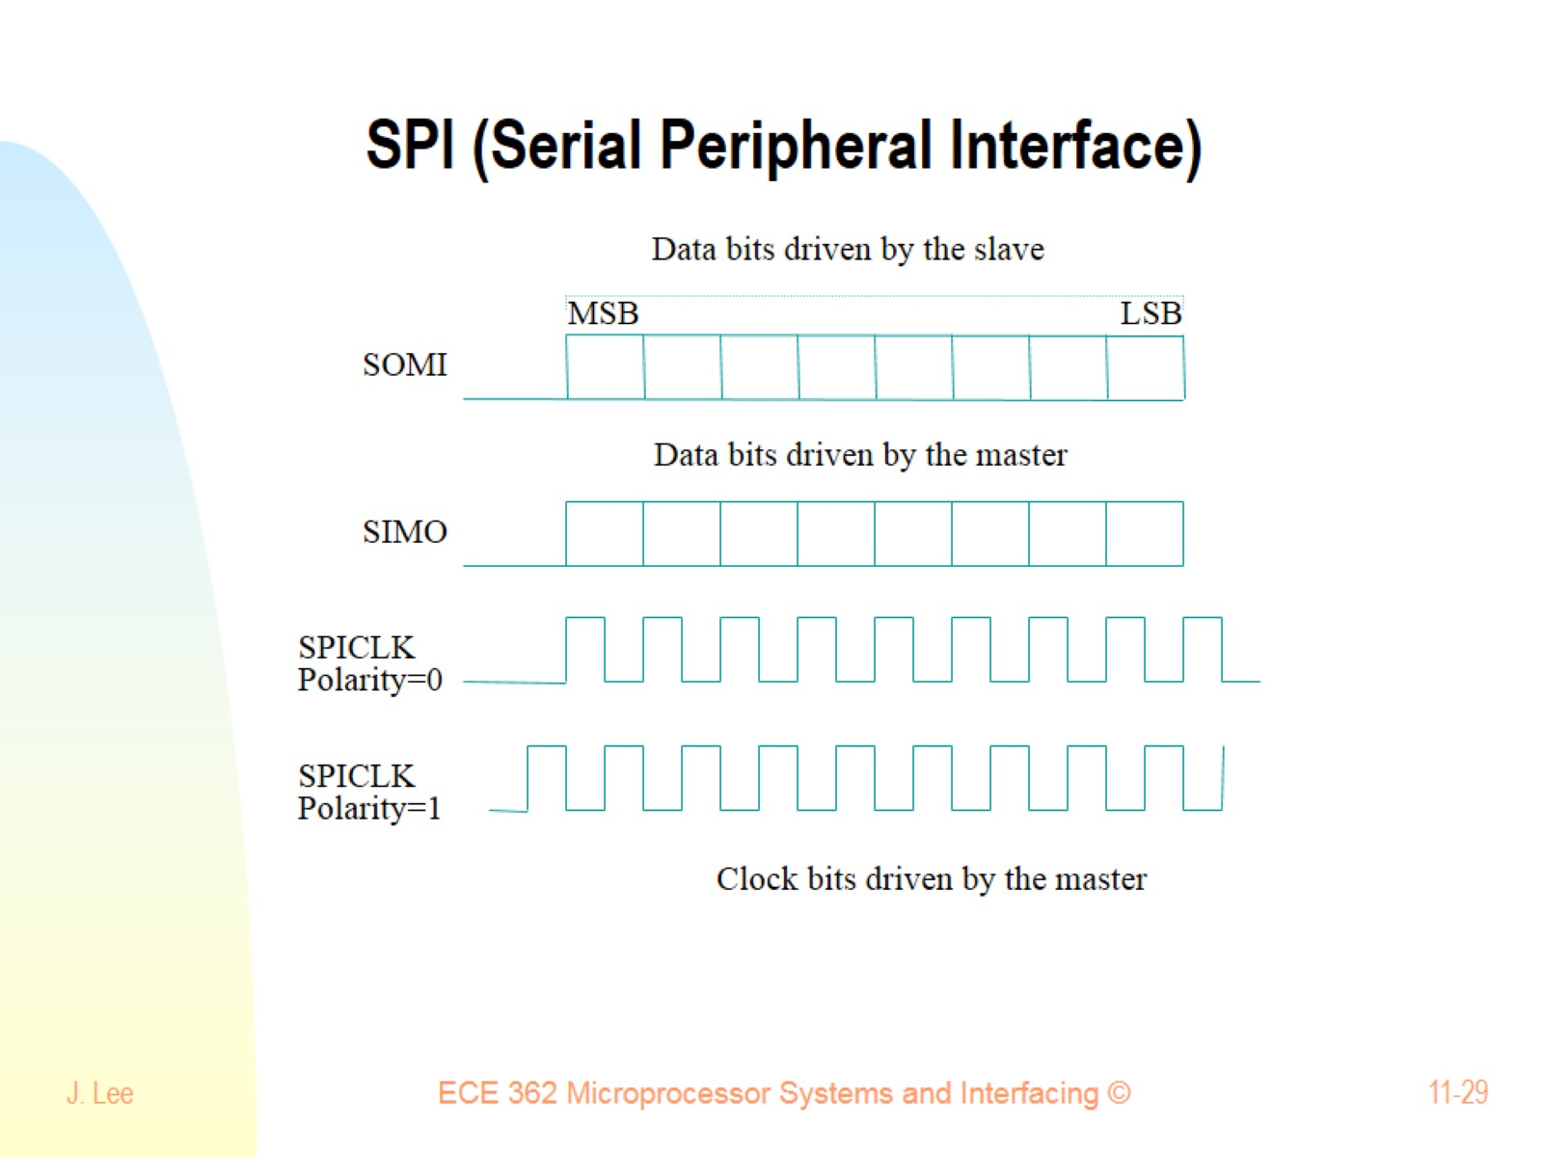
SPI (Serial Peripheral Interface)

Slide 30
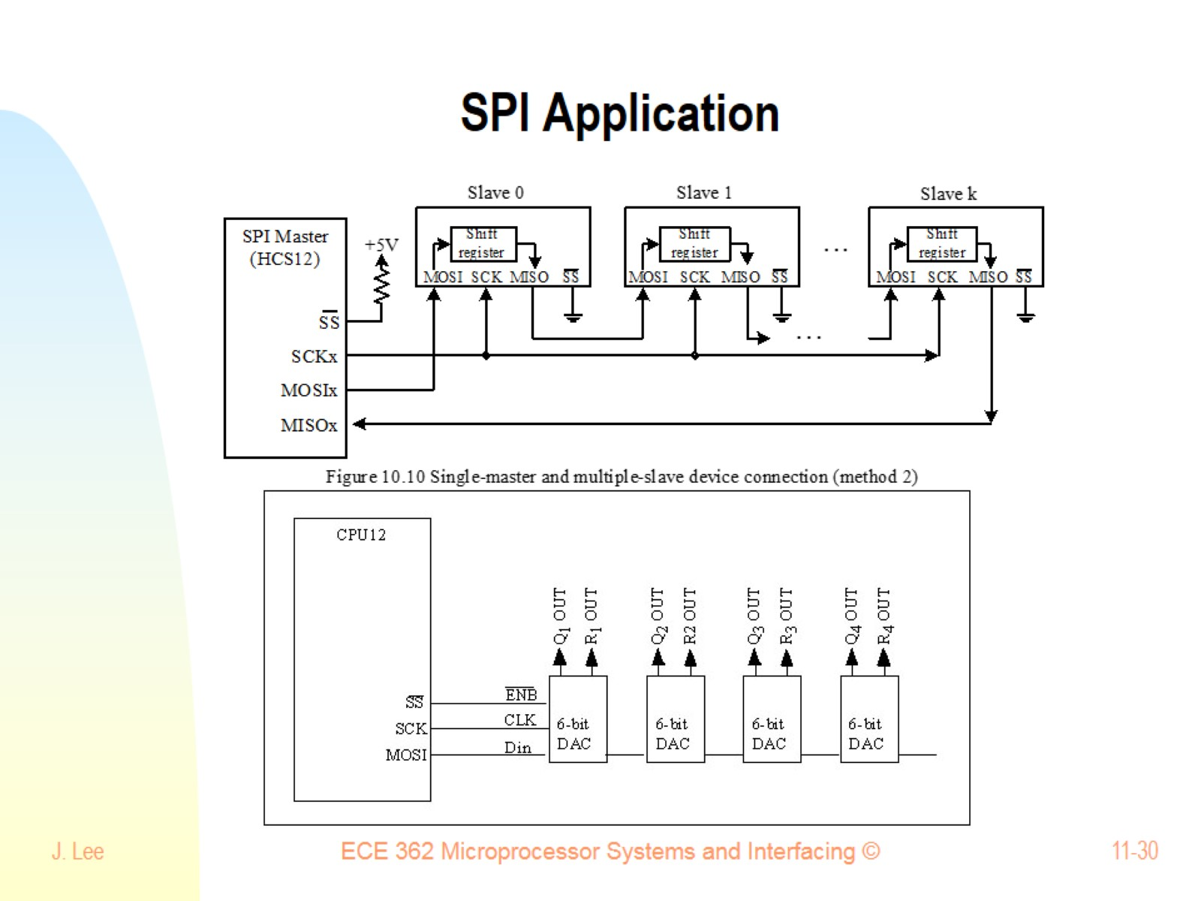
SPI Application

Slide 31
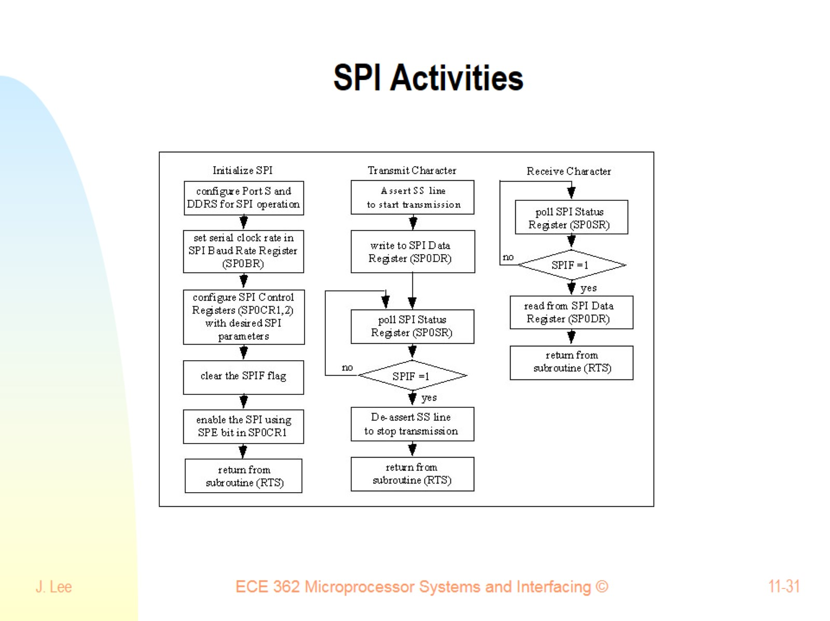
SPI Activities

Slide 32
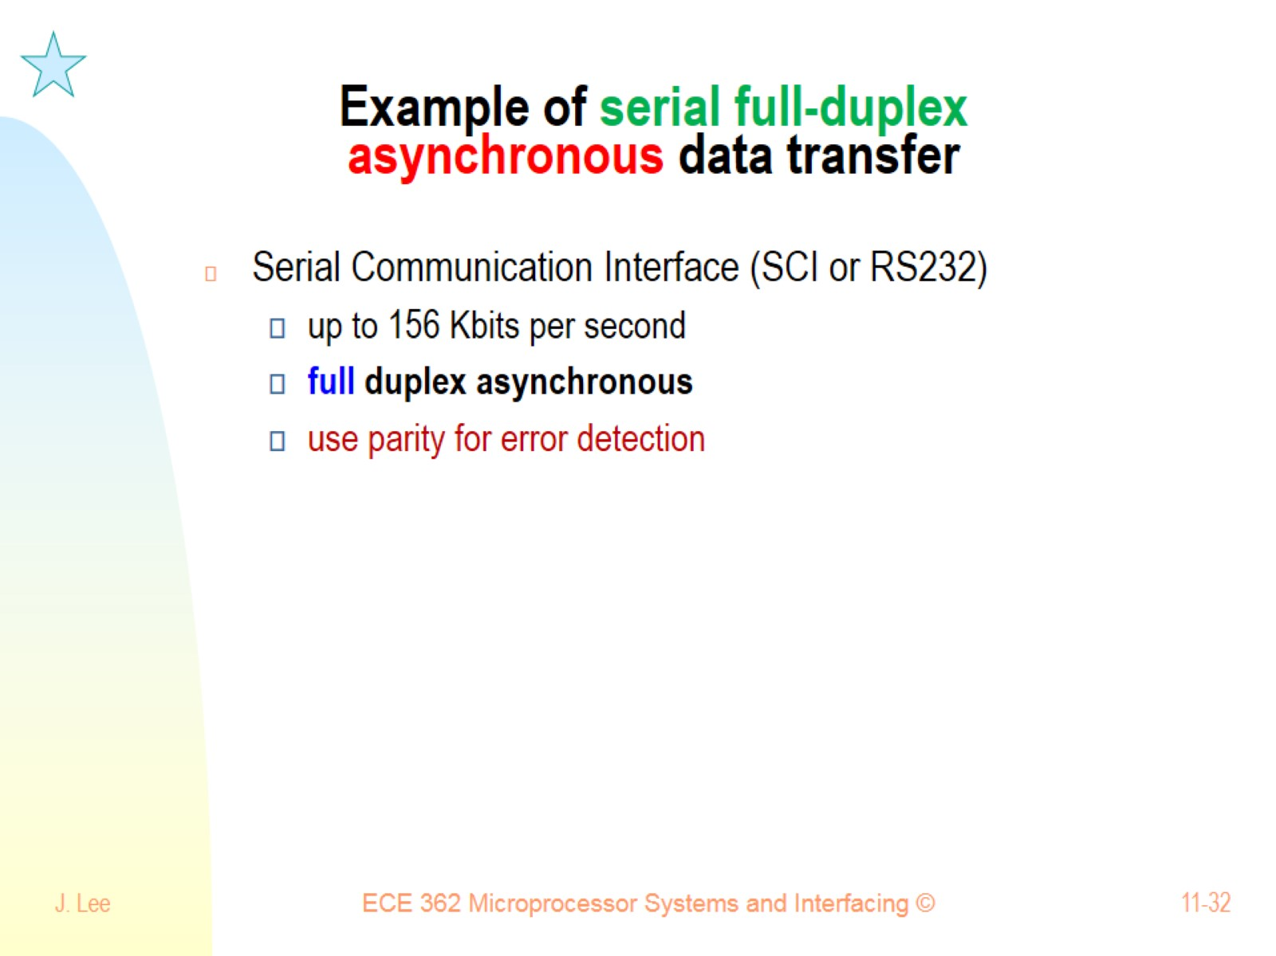
Example of serial full-duplex asynchronous data transfer

Slide 33
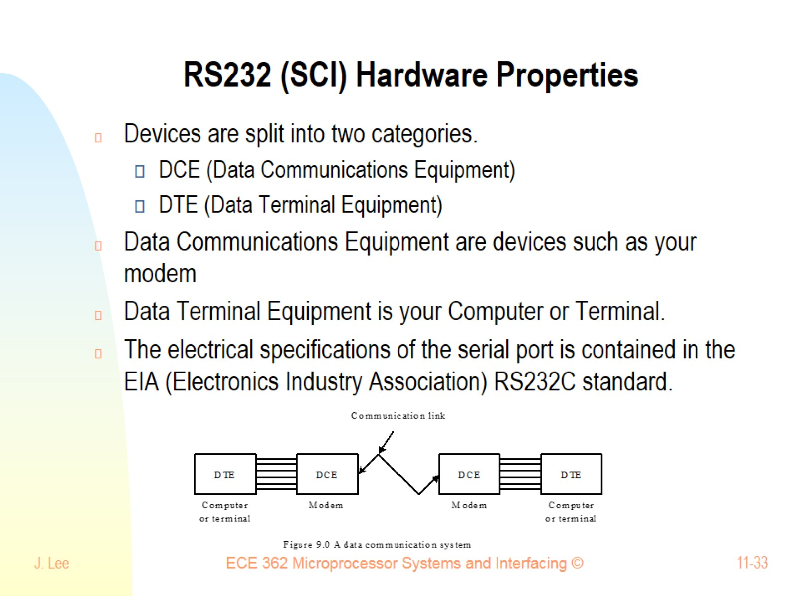
RS232 (SCI) Hardware Properties

Slide 34
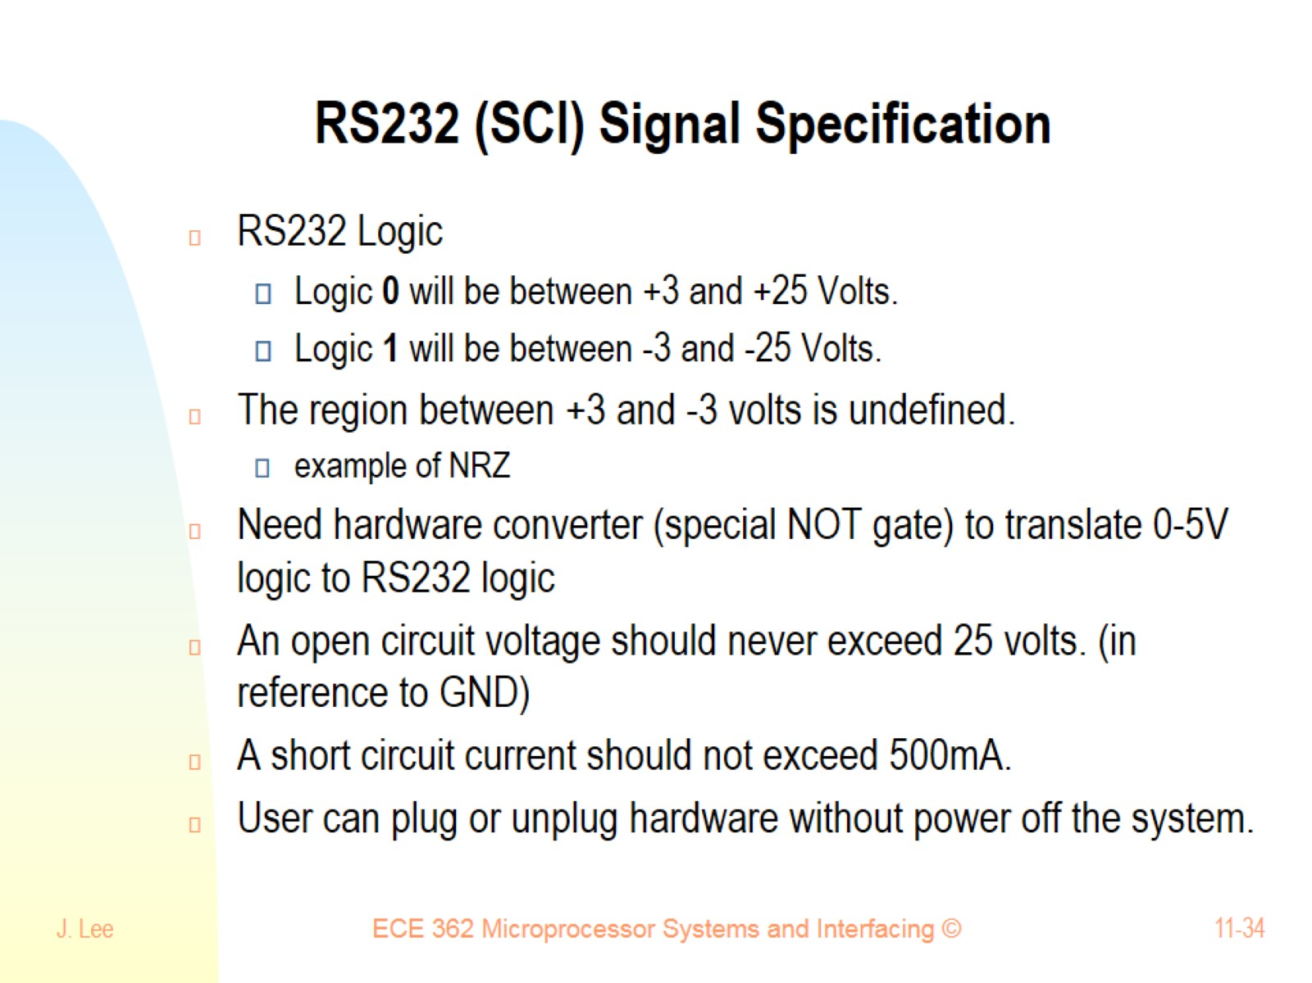
RS232 (SCI) Signal Specification

Slide 35
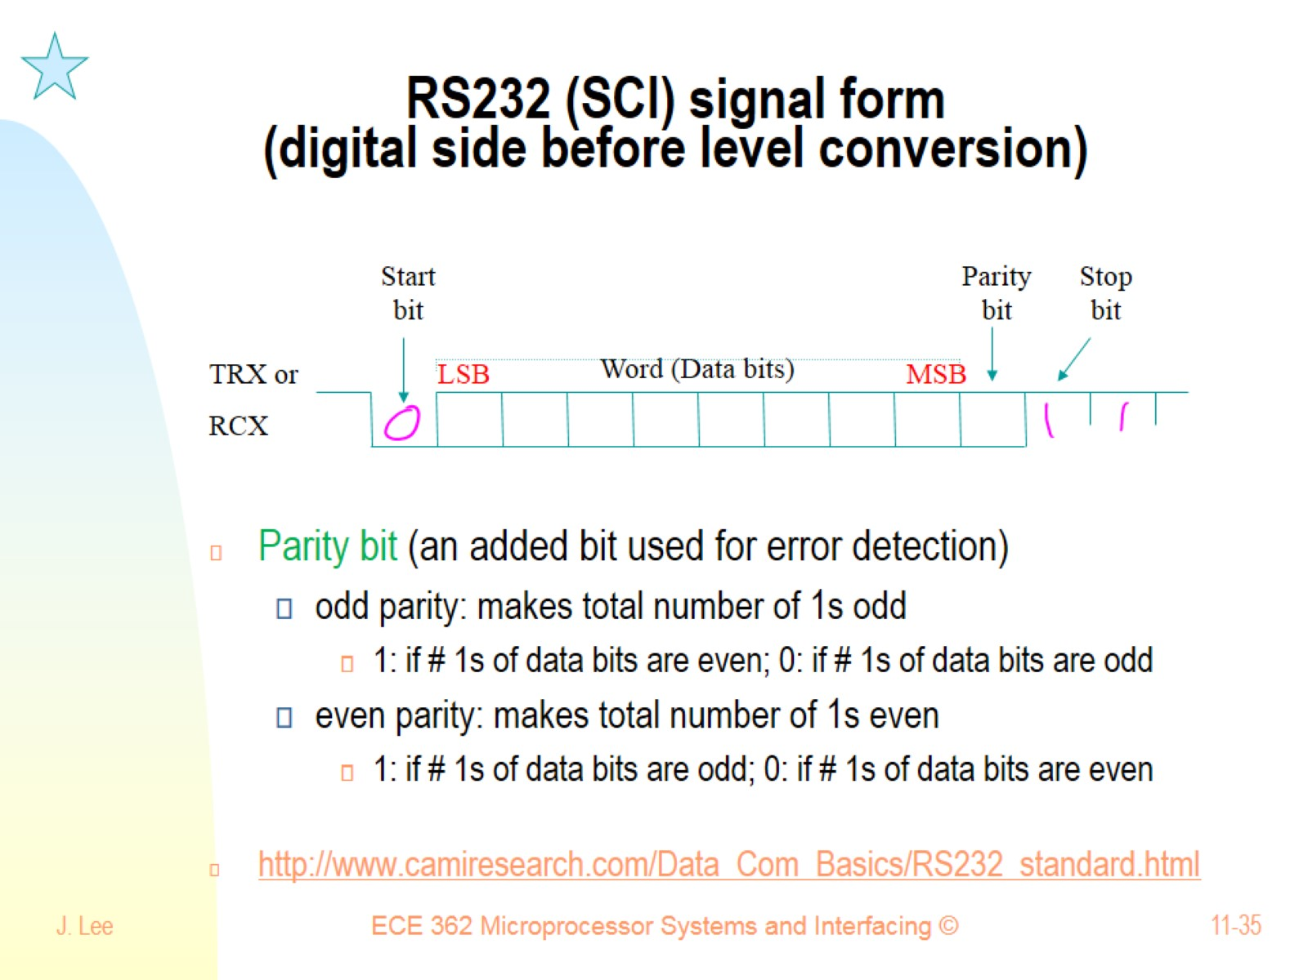
RS232 (SCI) signal form (digital side before level conversion)

Slide 36
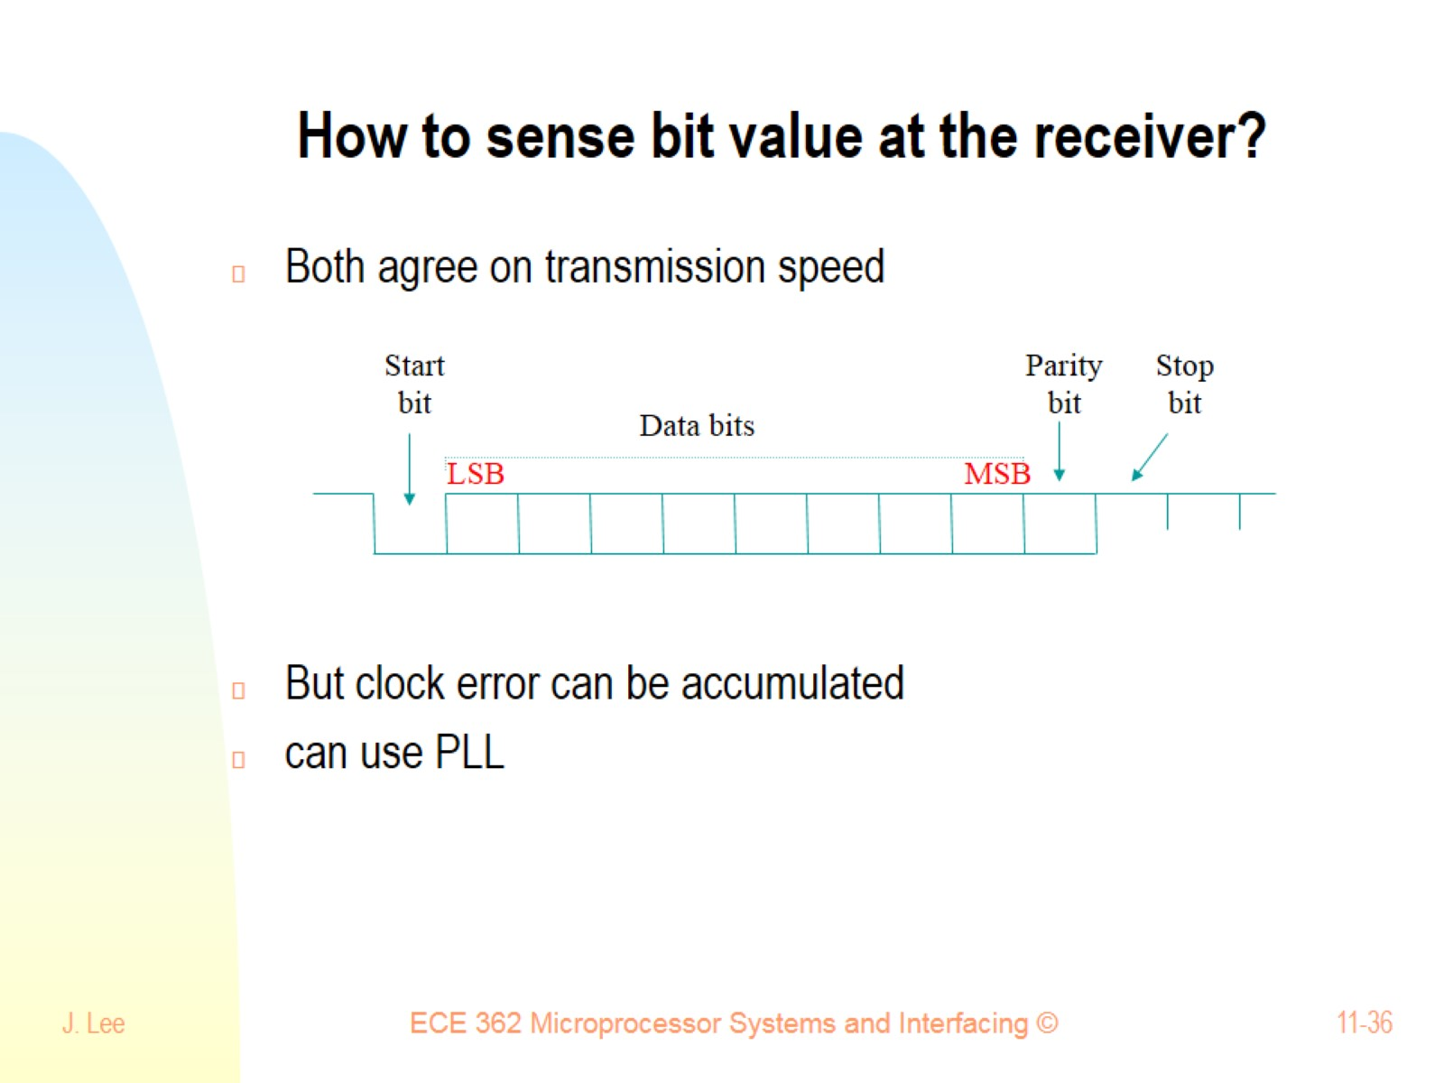
How to sense bit value at the receiver?

Slide 37
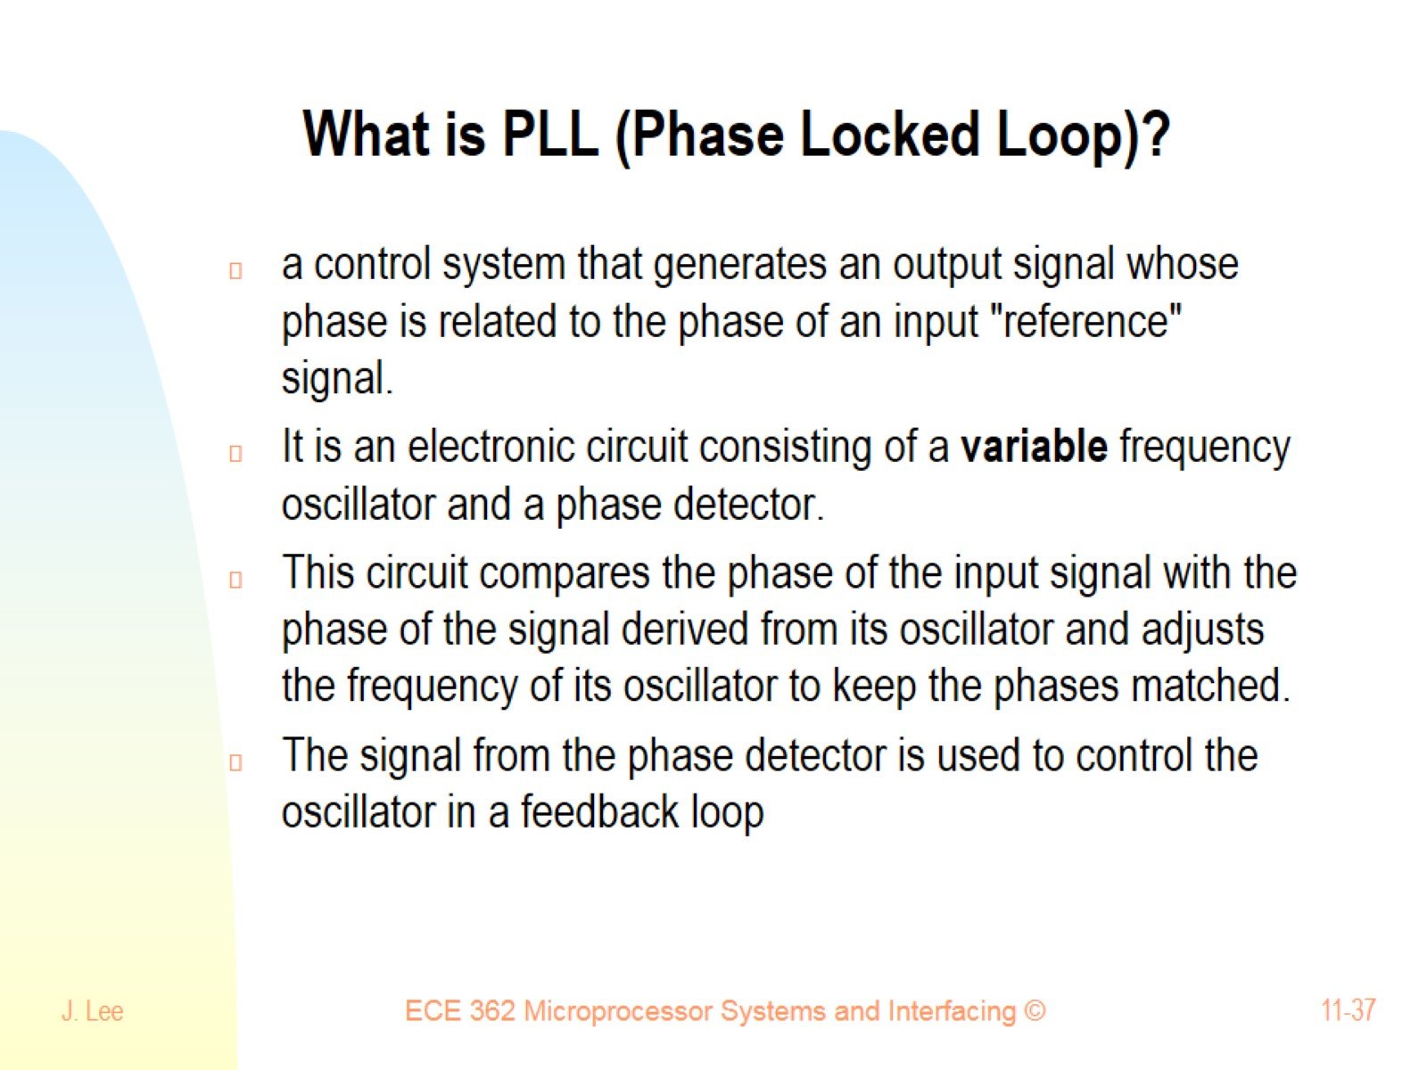
What is PLL (Phase Locked Loop)?

Slide 38
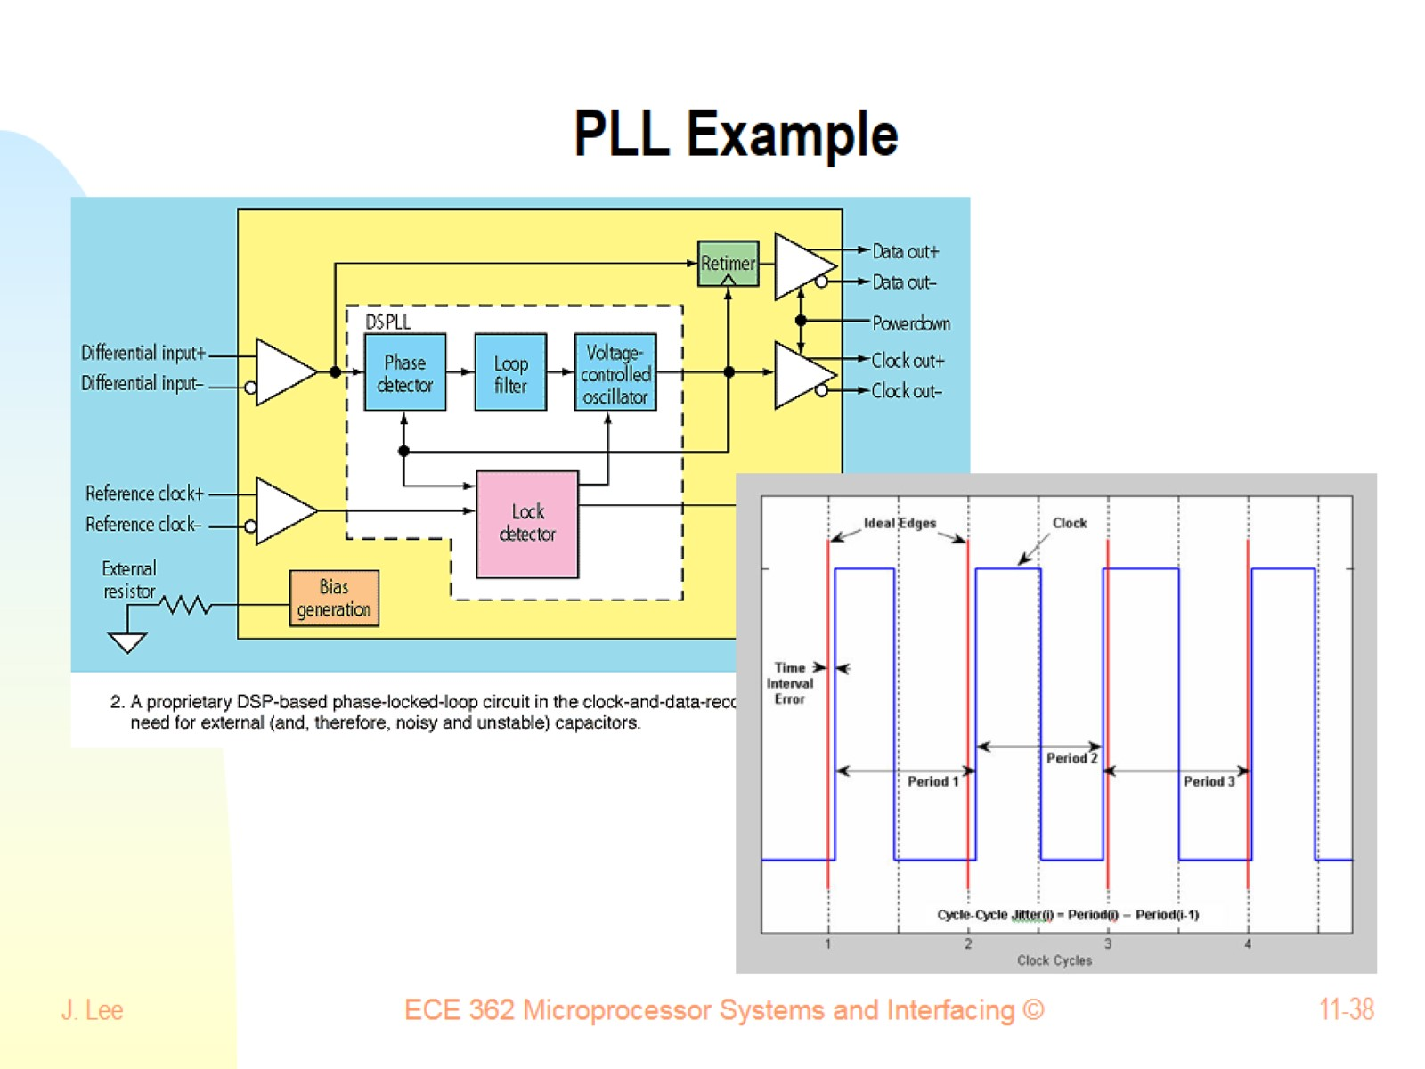
PLL Example

Slide 39
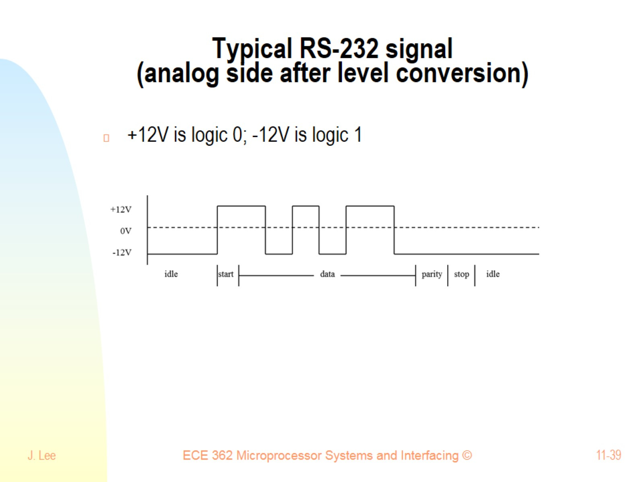
Typical RS-232 signal (analog side after level conversion)

Slide 40
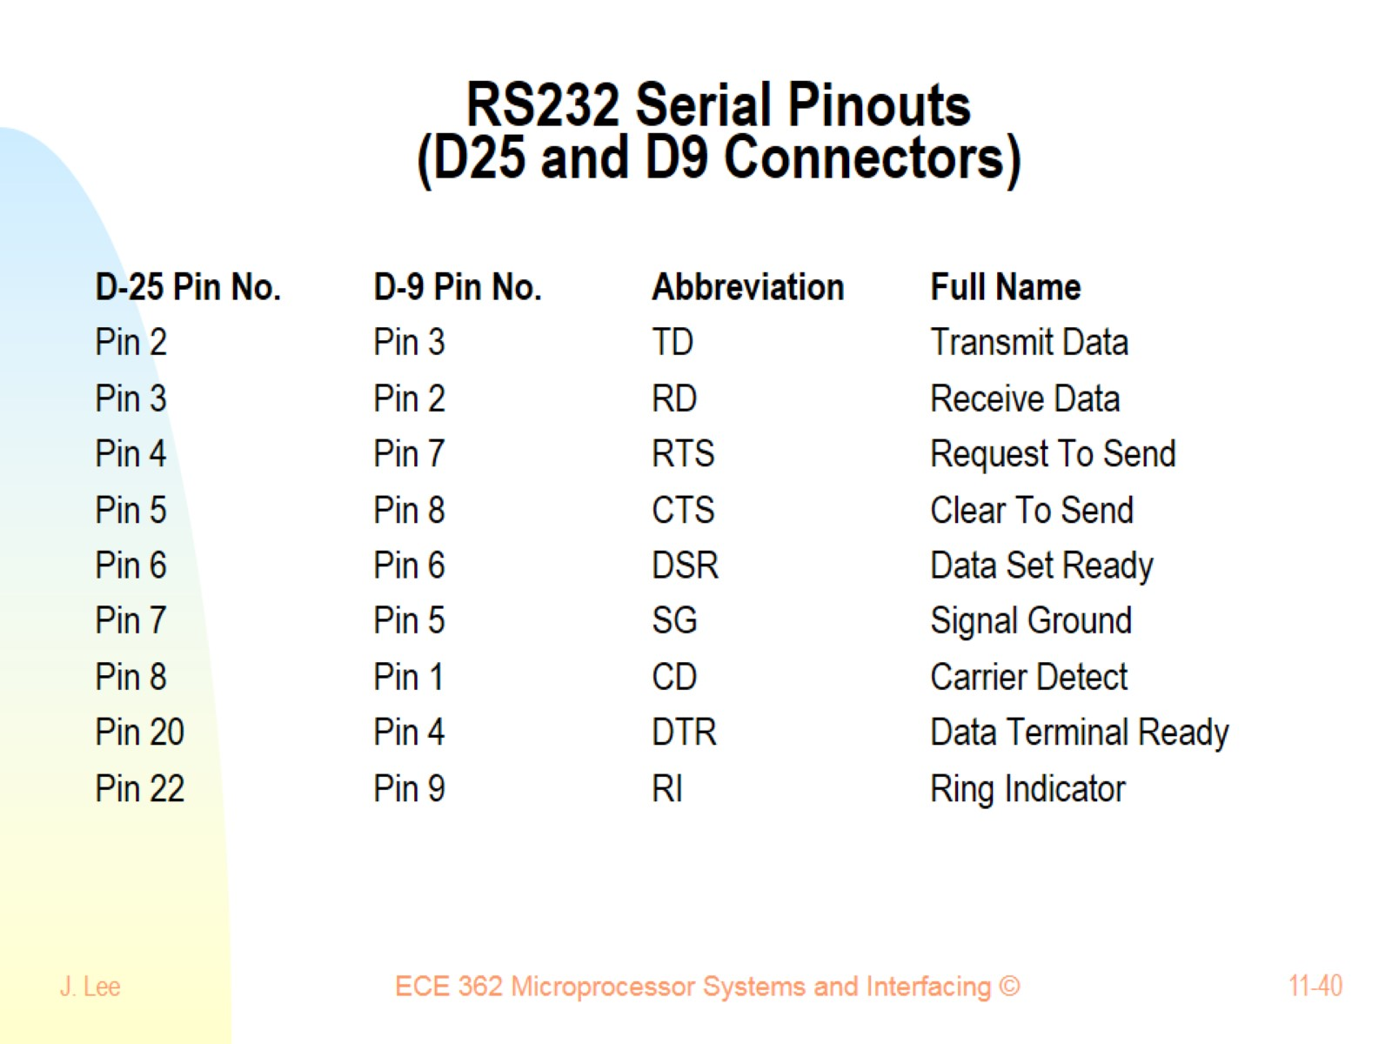
RS232 Serial Pinouts (D25 and D9 Connectors)

Slide 41
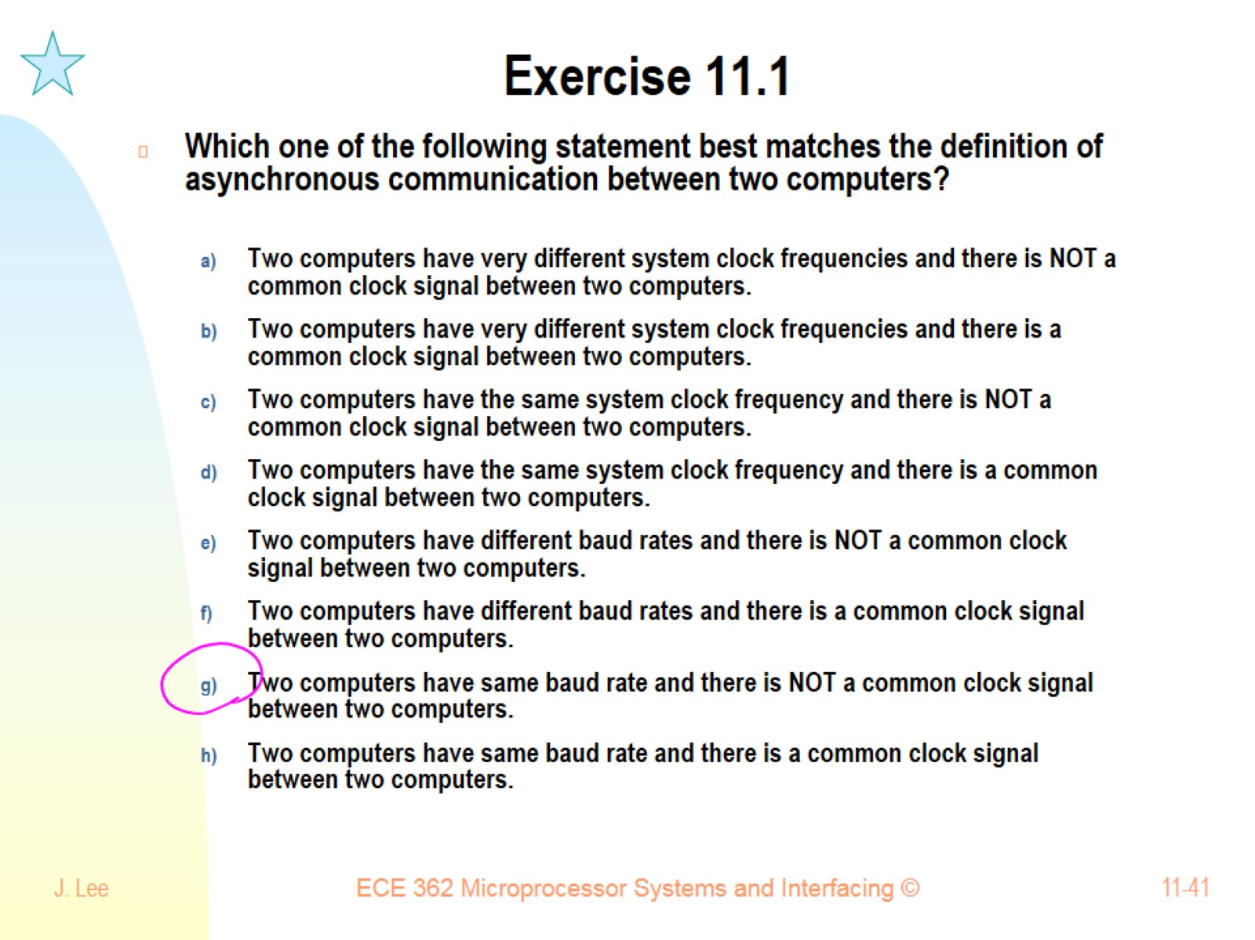
Exercise 11.1

Slide 42
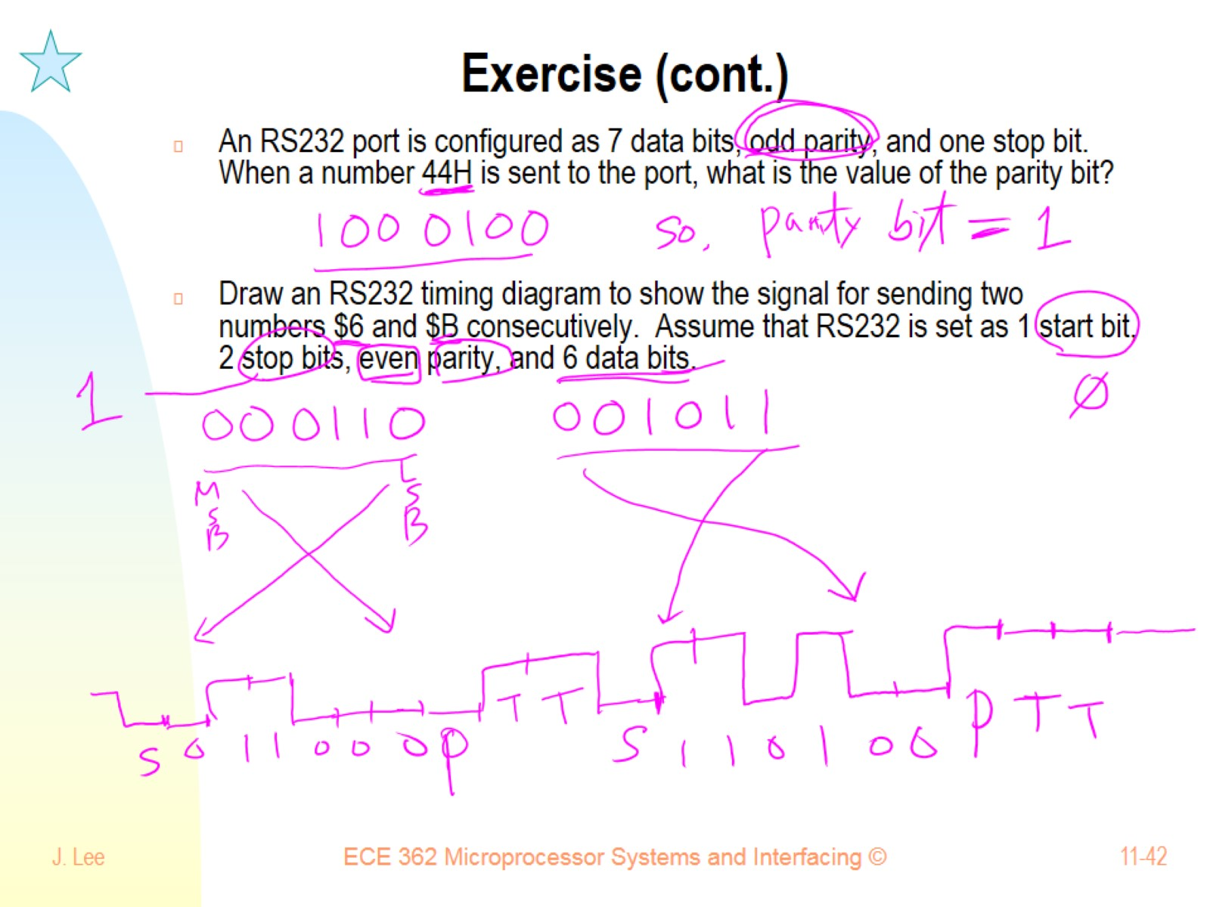
Exercise (cont.)

Slide 43
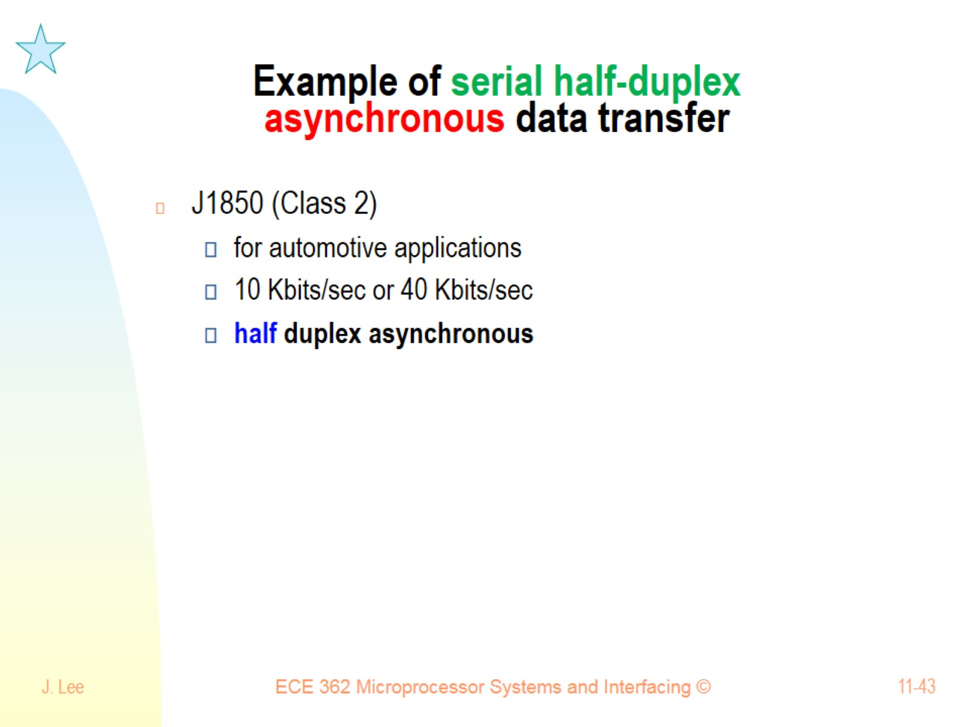
Example of serial half-duplex asynchronous data transfer

Slide 44
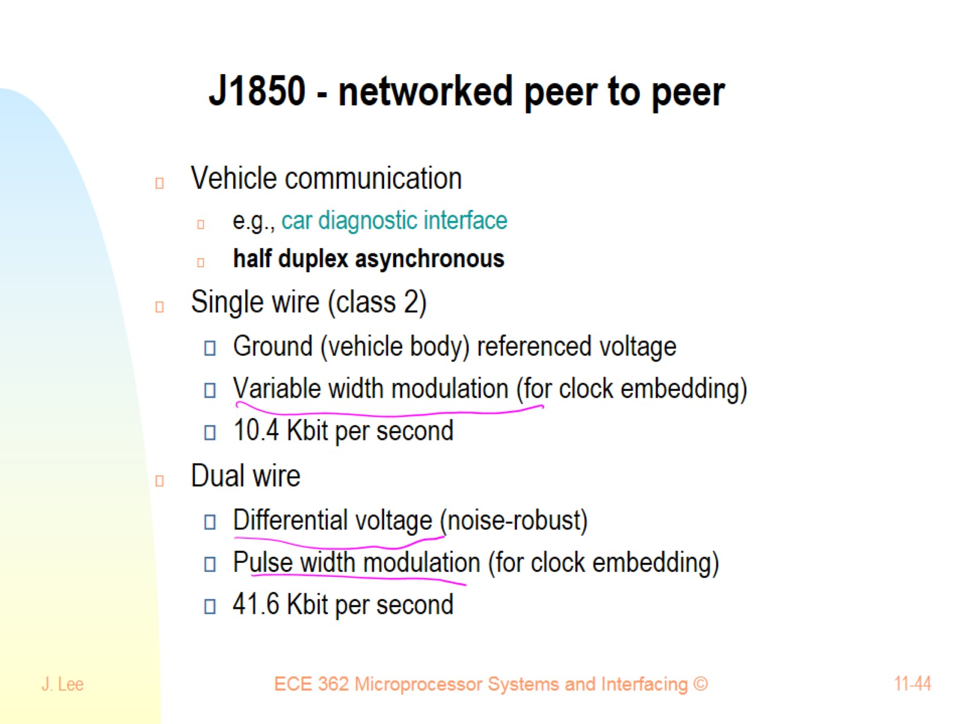
J1850 - networked peer to peer

Slide 45
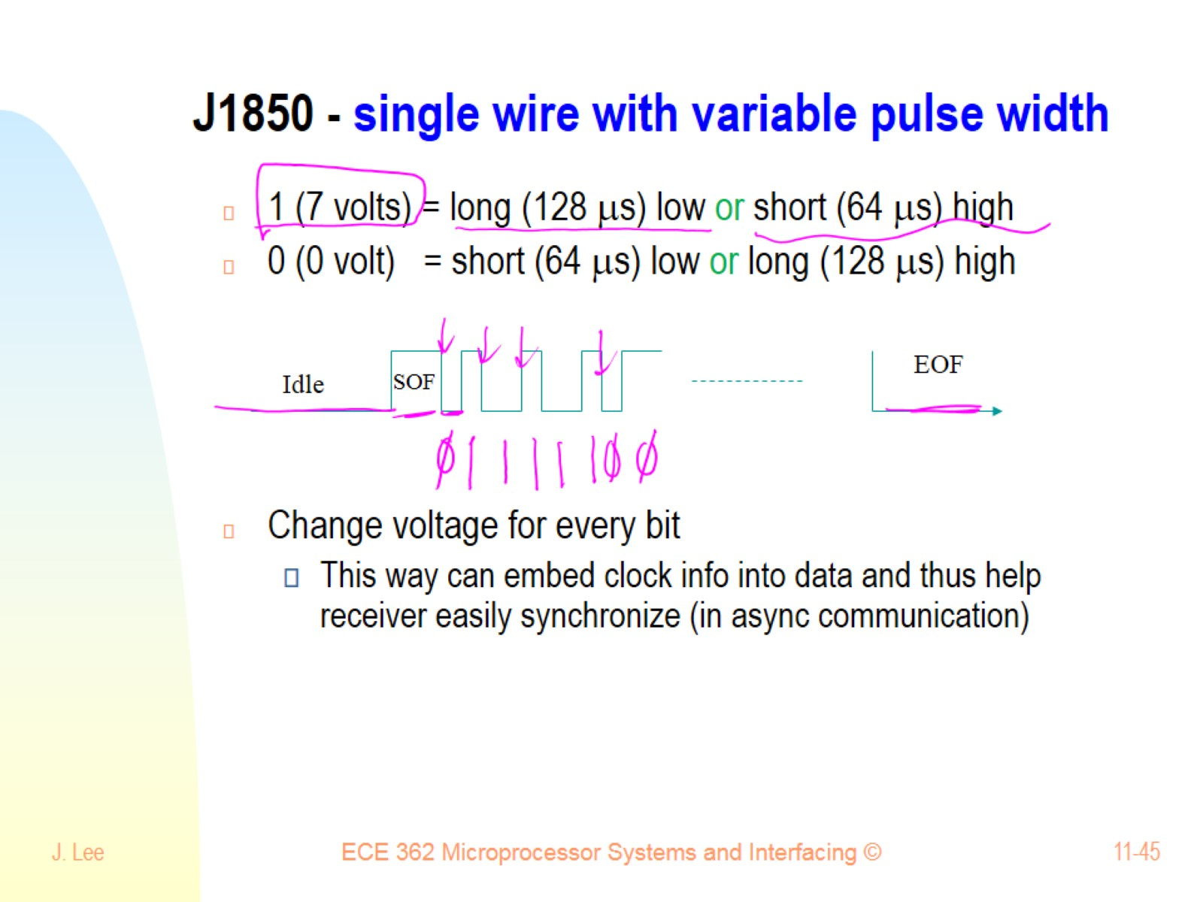
J1850 - single wire with variable pulse width

Slide 46
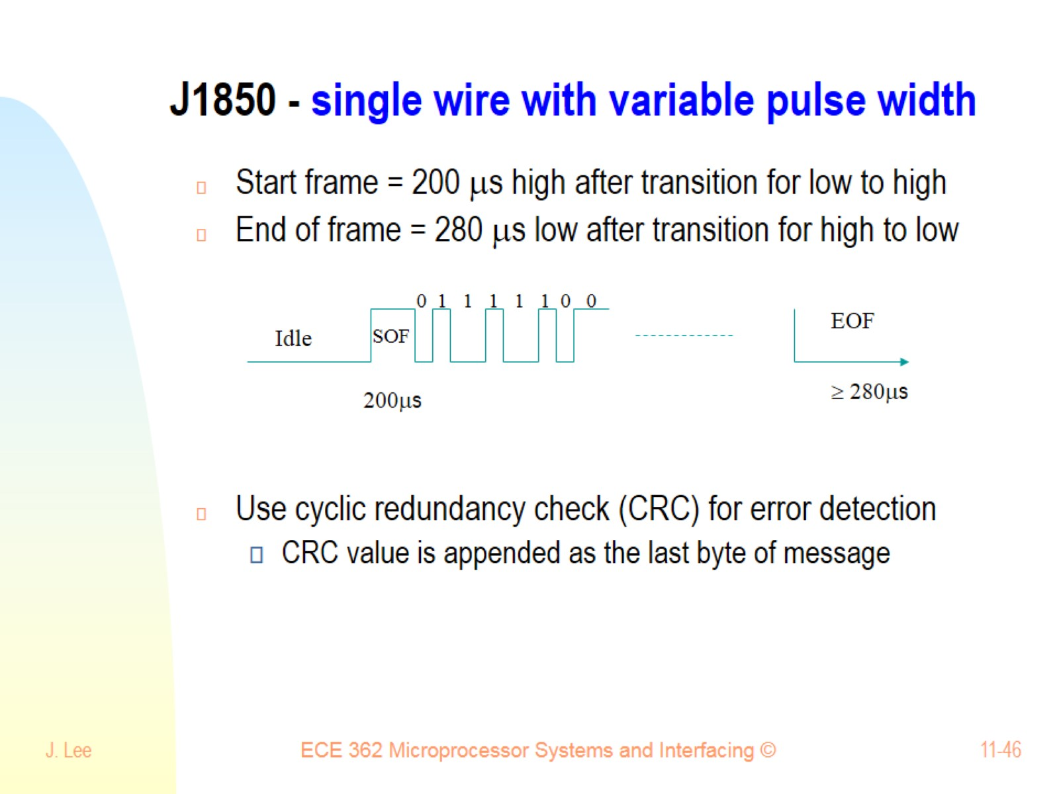
J1850 - single wire with variable pulse width

Slide 47
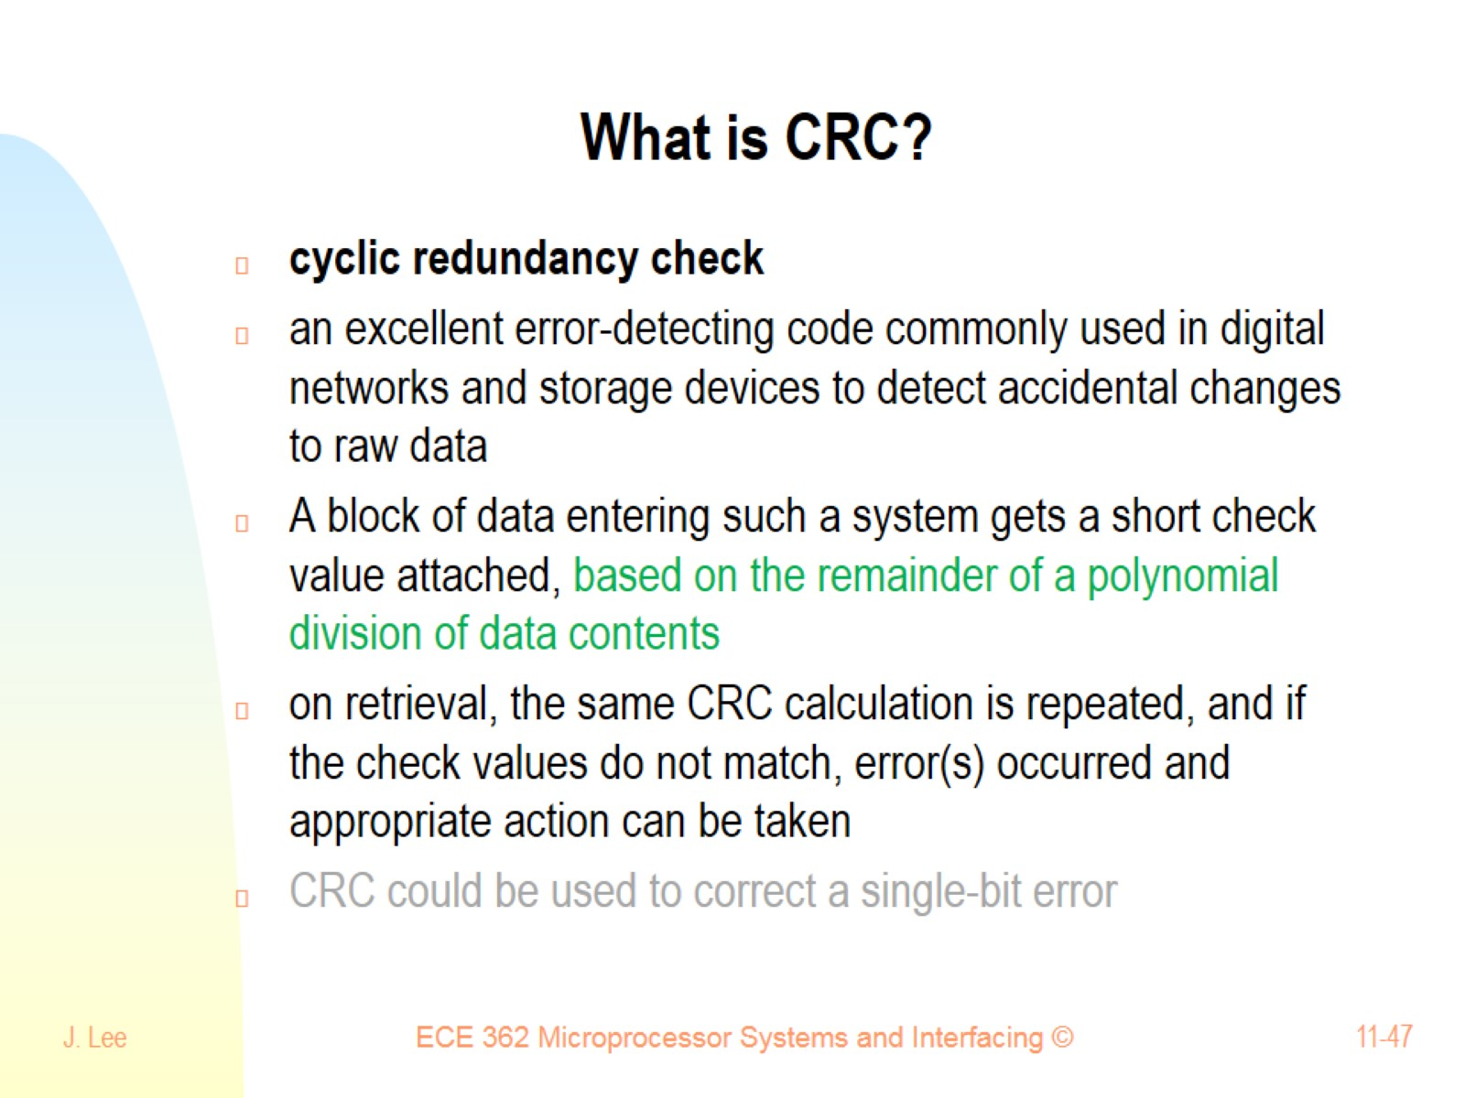
What is CRC?

Slide 48
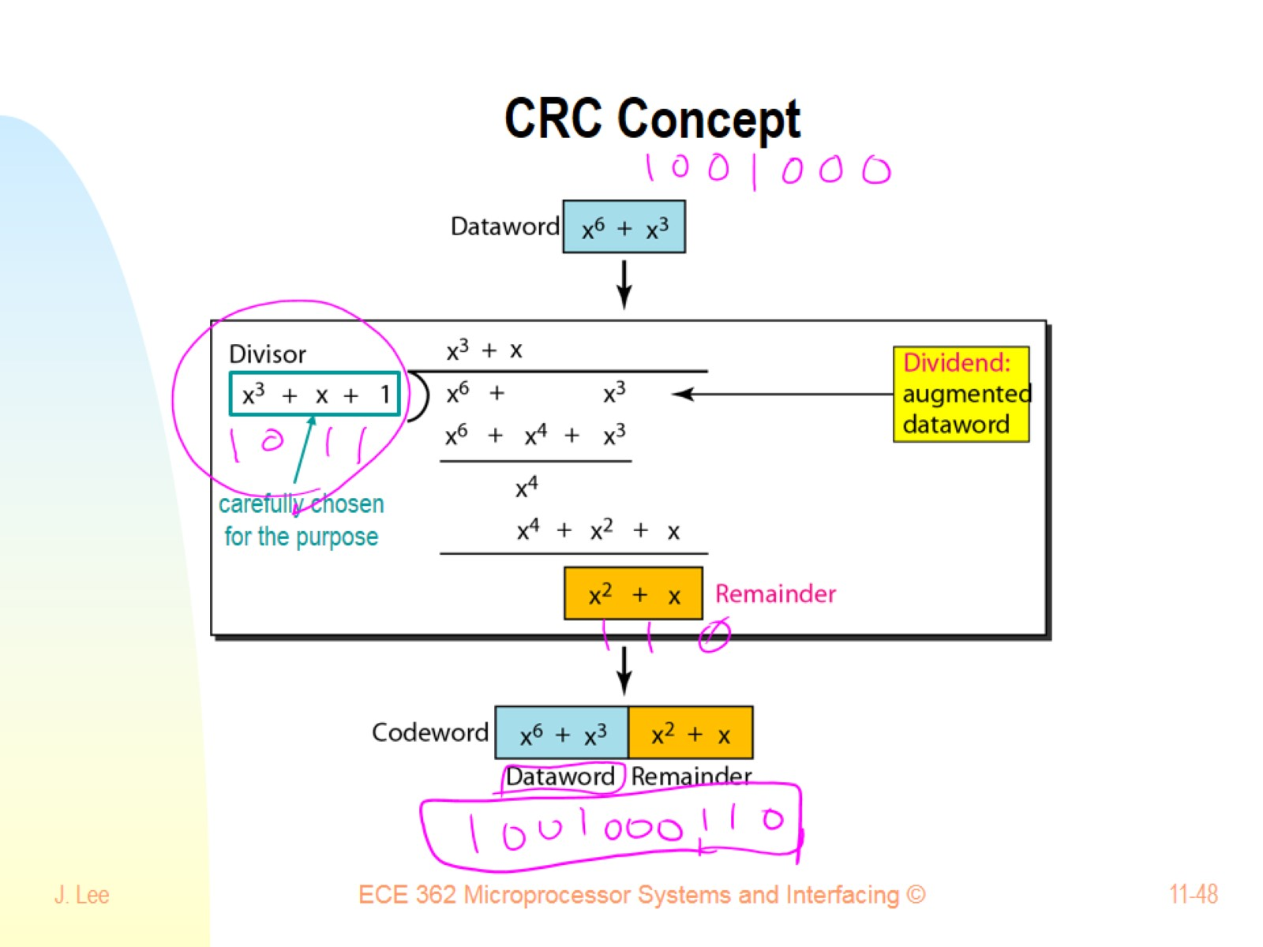
CRC Concept

Slide 49
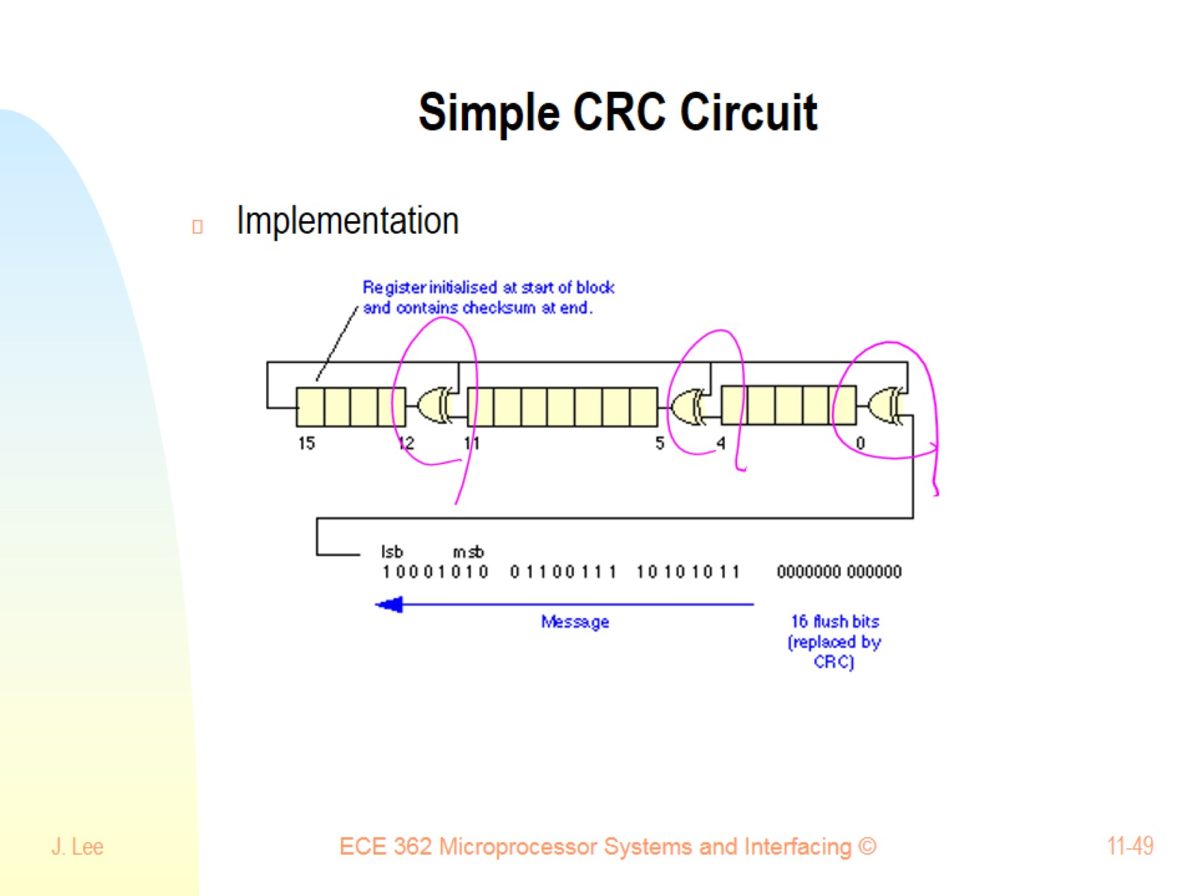
Simple CRC Circuit

Slide 50
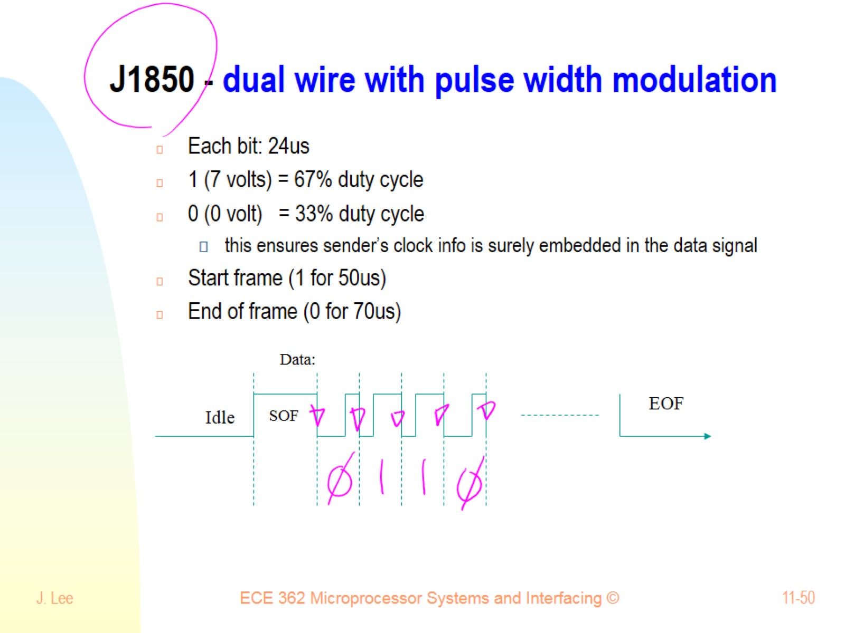
J1850 - dual wire with pulse width modulation

Slide 51

Exercise 11.2 - SCI communication

Slide 52

Direct memory access (DMA)

Slide 53

Direct memory access (DMA)

Slide 54

DMA structure

Slide 55

Memory ↔ Peripheral DMA operation

Slide 56

Summary

